Slide 1
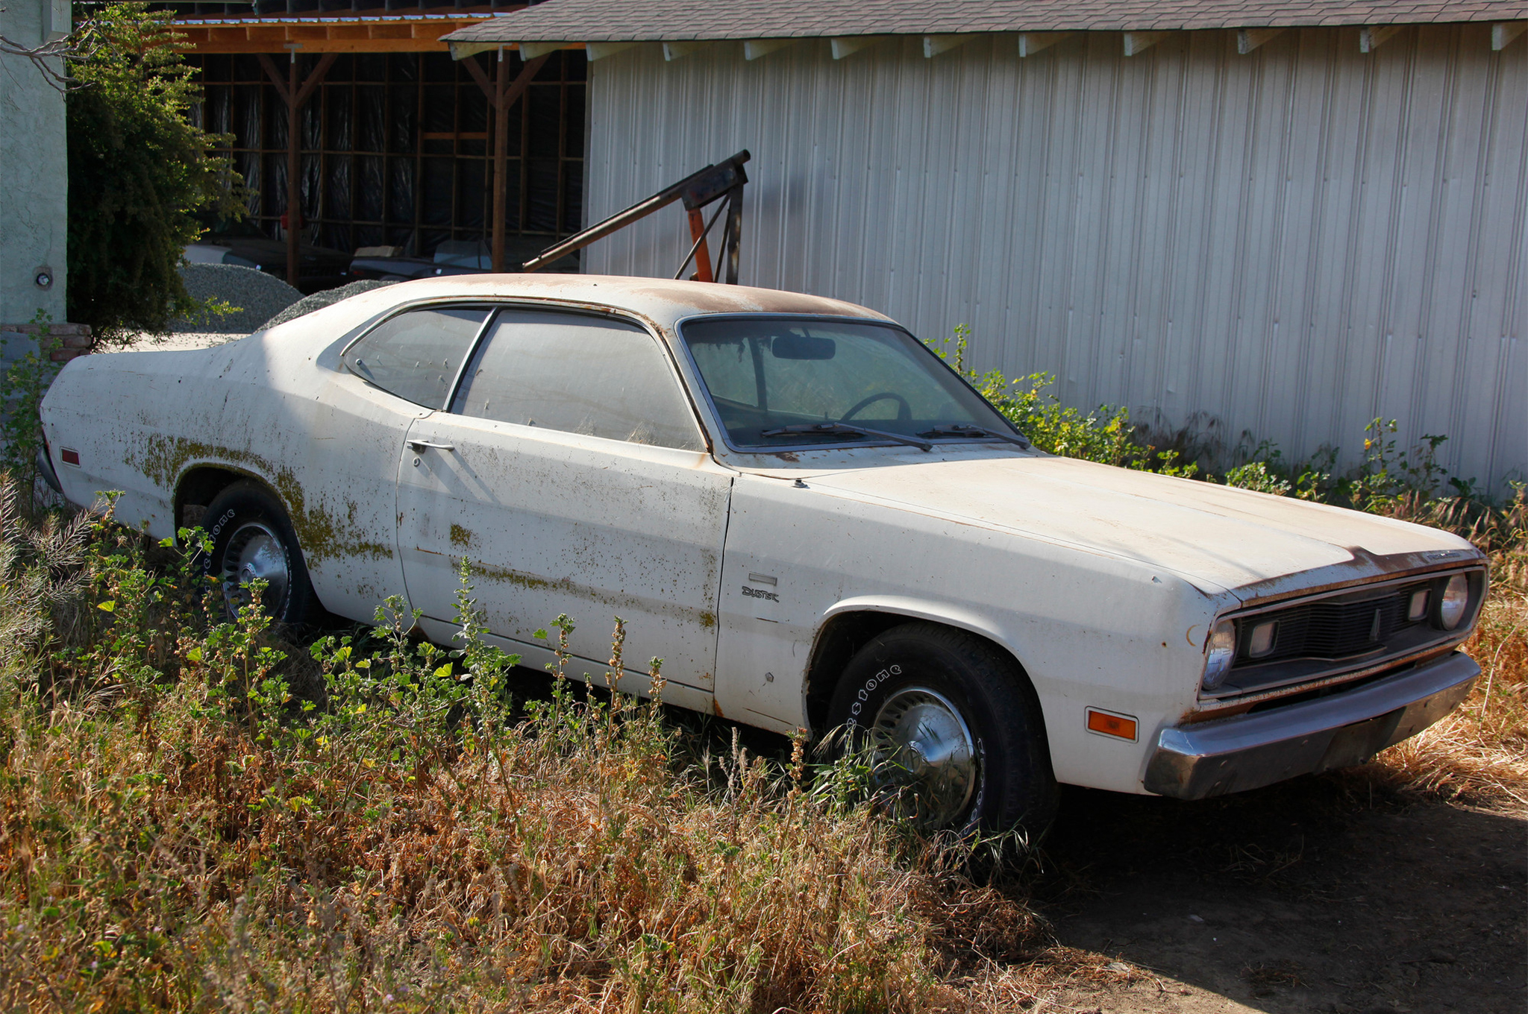

Slide 2


Slide 3

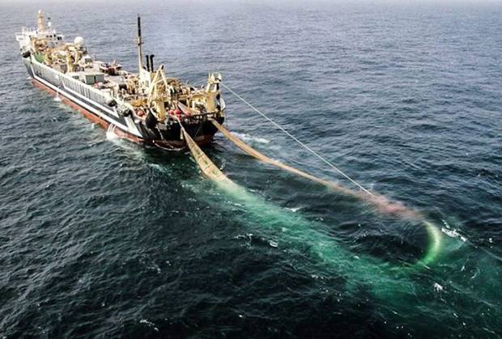
Luke 13:22 Then Jesus went through the towns and villages, teaching as he made his way to Jerusalem.

Slide 4
Luke 13:22 Then Jesus went through the towns and villages, teaching as he made his way to Jerusalem. 23 Someone asked him, ‘Lord, are only a few people going to be saved?’

Slide 5


Slide 6

The Missed Door
He said to them, 24 ‘Make every effort to enter through the narrow door, because many, I tell you, will try to enter and will not be able to. 25 Once the owner of the house gets up and closes the door, you will stand outside knocking and pleading, “Sir, open the door for us.” ‘But he will answer, “I don’t know you or where you come from.”
26 ‘Then you will say, “We ate and drank with you, and you taught in our streets.”
27 ‘But he will reply, “I don’t know you or where you come from. Away from me, all you evildoers!”

Slide 7
28 ‘There will be weeping there, and gnashing of teeth, when you see Abraham, Isaac and Jacob and all the prophets in the kingdom of God, but you yourselves thrown out. 29 People will come from east and west and north and south, and will take their places at the feast in the kingdom of God.
30 Indeed there are those who are last who will be first, and first who will be last.’

Slide 8

From the text, what do we know about the group who end up distraught at missing the narrow door?
many, I tell you, will try to enter will not be able to. 25 Once the owner of the house gets up and closes the door, you will stand outside knocking and pleading “Sir, open the door for us.” ‘But he will answer, “I don’t know you or where you come from.”
26 ‘Then you will say, “We ate and drank with you, and you taught in our streets.” 27 ‘But he will reply, “I don’t know you or where you come from. Away from me, all you evildoers!” 28 ‘There will be weeping there, and gnashing of teeth, when you see Abraham, Isaac and Jacob and all the prophets in the kingdom of God, but you yourselves thrown out. 29 People will come from east and west and north and south, and will take their places at the feast in the kingdom of God. 30 Indeed there are those who are last who will be first, and first who will be last.’

Slide 9
From the text, what do we know about the group who end up distraught at missing the narrow door?
many, I tell you, will try to enter will not be able to. 25 Once the owner of the house gets up and closes the door, you will stand outside knocking and pleading “Sir, open the door for us.” ‘But he will answer, “I don’t know you or where you come from.”
26 ‘Then you will say, “We ate and drank with you, and you taught in our streets.” 27 ‘But he will reply, “I don’t know you or where you come from. Away from me, all you evildoers!” 28 ‘There will be weeping there, and gnashing of teeth, when you see Abraham, Isaac and Jacob and all the prophets in the kingdom of God, but you yourselves thrown out. 29 People will come from east and west and north and south, and will take their places at the feast in the kingdom of God. 30 Indeed there are those who are last who will be first, and first who will be last.’

Slide 10
From the text, what do we know about the group who end up distraught at missing the narrow door?
many, I tell you, will try to enter will not be able to. 25 Once the owner of the house gets up and closes the door, you will stand outside knocking and pleading “Sir, open the door for us.” ‘But he will answer, “I don’t know you or where you come from.”
26 ‘Then you will say, “We ate and drank with you, and you taught in our streets.” 27 ‘But he will reply, “I don’t know you or where you come from. Away from me, all you evildoers!” 28 ‘There will be weeping there, and gnashing of teeth, when you see Abraham, Isaac and Jacob and all the prophets in the kingdom of God, but you yourselves thrown out. 29 People will come from east and west and north and south, and will take their places at the feast in the kingdom of God. 30 Indeed there are those who are last who will be first, and first who will be last.’

Slide 11
From the text, what do we know about the group who end up distraught at missing the narrow door?
many, I tell you, will try to enter will not be able to. 25 Once the owner of the house gets up and closes the door, you will stand outside knocking and pleading “Sir, open the door for us.” ‘But he will answer, “I don’t know you or where you come from.”
26 ‘Then you will say, “We ate and drank with you, and you taught in our streets.” 27 ‘But he will reply, “I don’t know you or where you come from. Away from me, all you evildoers!” 28 ‘There will be weeping there, and gnashing of teeth, when you see Abraham, Isaac and Jacob and all the prophets in the kingdom of God, but you yourselves thrown out. 29 People will come from east and west and north and south, and will take their places at the feast in the kingdom of God. 30 Indeed there are those who are last who will be first, and first who will be last.’

Slide 12

From the text, what do we know about the group who end up distraught at missing the narrow door?
many, I tell you, will try to enter will not be able to. 25 Once the owner of the house gets up and closes the door, you will stand outside knocking and pleading “Sir, open the door for us.” ‘But he will answer, “I don’t know you or where you come from.”
26 ‘Then you will say, “We ate and drank with you, and you taught in our streets.” 27 ‘But he will reply, “I don’t know you or where you come from. Away from me, all you evildoers!” 28 ‘There will be weeping there, and gnashing of teeth, when you see Abraham, Isaac and Jacob and all the prophets in the kingdom of God, but you yourselves thrown out. 29 People will come from east and west and north and south, and will take their places at the feast in the kingdom of God. 30 Indeed there are those who are last who will be first, and first who will be last.’

Slide 13
The Missed Door
What door were those excluded as evil doers trusting to get them into the realized Kingdom of God?

Slide 14
The Missed Door
Those trusting in their Abrahamic lineage and/or mere familiarity with Jesus and his teachings will be distraught over their exclusion as evil doers while Gentiles enter God’s realized kingdom.
Evil doers
I never knew you
They thought they were in.

Slide 15

The Missed Door Today
Those presuming upon their religious heritage or mere familiarity with Jesus and his teachings will be distraught over their exclusion from God’s kingdom as evil doers while others are included instead.
What dangers lie behind or within familiarity?

Slide 16
What false doors are people presuming will gain them access to heaven?
Good living/Good deeds
Other religions
‘Christian’ cults
Born into Christian family/heritage
Church attendance
Serving in the church
Attending fellowship events
Bible studies/theological degree

Slide 17
The Missed Door
The Entered Door

Slide 18
The Entered Door
24 ‘Make every effort to enter through the narrow door . . . 25 Once the owner of the house gets up and closes the door, you will stand outside knocking and pleading, . . . 29 People will come from east and west and north and south, and will take their places at the feast in the kingdom of God.

Slide 19
The Entered Door
24 ‘Make every effort to enter through the narrow door . . . 25 Once the owner of the house gets up and closes the door, you will stand outside knocking and pleading, . . . 29 People will come from east and west and north and south, and will take their places at the feast in the kingdom of God.

Slide 20
The Entered Door
24 ‘Make every effort to enter through the narrow door . . . 25 Once the owner of the house gets up and closes the door, you will stand outside knocking and pleading, . . . 29 People will come from east and west and north and south, and will take their places at the feast in the kingdom of God.
Large numbers from every race, who made the effort to enter the temporarily opened narrow door, will escape God’s condemnation and be welcomed into God’s fully realized eternal kingdom.

Slide 21
The Entered Door
24 ‘Make every effort to enter through the narrow door . . . 25 Once the owner of the house gets up and closes the door, you will stand outside knocking and pleading, . . . 29 People will come from east and west and north and south, and will take their places at the feast in the kingdom of God.
From Luke’s account, what has Luke told us so far that helps us identify the ‘narrow door’ into God’s Kingdom?

Slide 22

From Luke’s account, what kind of effort is needed to enter through the narrow door?
Careful listening
Repentance & its fruit
Receive God’s Mercy
Faith in the Lord Jesus
Following Jesus now is life’s priority
JESUS

Slide 23
The Entered Door
Large numbers from every race, who carefully listens to Jesus’ words to repent and trust in him as Saviour, will escape God’s condemnation and be included into God’s eternal kingdom.
In the net already
Will join Abraham and the patriarchs and the prophets

Slide 24

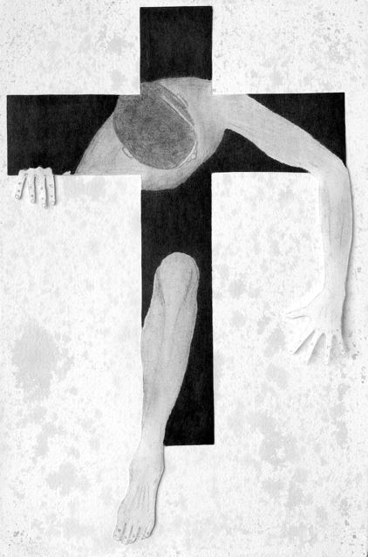

Slide 25
The Rejected Door

Slide 26
The Rejected Door
31 At that time some Pharisees came to Jesus and said to him, ‘Leave this place and go somewhere else. Herod wants to kill you.’ 32 He replied, ‘Go and tell that fox, “I will keep on driving out demons and healing people today and tomorrow, and on the third day I will reach my goal.” 33 In any case, I must press on today and tomorrow and the next day – for surely no prophet can die outside Jerusalem!
Jesus’ determination to fulfil his mission

Slide 27
34 ‘Jerusalem, Jerusalem, you who kill the prophets and stone those sent to you, how often I have longed to gather your children together, as a hen gathers her chicks under her wings, and you were not willing. 35 Look, your house is left to you desolate. I tell you, you will not see me again until you say, “Blessed is he who comes in the name of the Lord.”

Slide 28
34 ‘Jerusalem, Jerusalem, you who kill the prophets and stone those sent to you, how often I have longed to gather your children together, as a hen gathers her chicks under her wings, and you were not willing. 35 Look, your house is left to you desolate. I tell you, you will not see me again until you say, “Blessed is he who comes in the name of the Lord.”

Slide 29
34 ‘Jerusalem, Jerusalem, you who kill the prophets and stone those sent to you, how often I have longed to gather your children together, as a hen gathers her chicks under her wings, and you were not willing. 35 Look, your house is left to you desolate. I tell you, you will not see me again until you say, “Blessed is he who comes in the name of the Lord.”

Slide 30
34 ‘Jerusalem, Jerusalem, you who kill the prophets and stone those sent to you, how often I have longed to gather your children together, as a hen gathers her chicks under her wings, and you were not willing. 35 Look, your house is left to you desolate. I tell you, you will not see me again until you say, “Blessed is he who comes in the name of the Lord.”

Slide 31
34 ‘Jerusalem, Jerusalem, you who kill the prophets and stone those sent to you, how often I have longed to gather your children together, as a hen gathers her chicks under her wings, and you were not willing. 35 Look, your house is left to you desolate. I tell you, you will not see me again until you say, “Blessed is he who comes in the name of the Lord.”

Slide 32
The Rejected Door
Judah’s social-religious heart, just as it had rejected God’s prophets before, stubbornly rejected the Lord’s loving appeal to repent, be reconciled to him and be included into God’s eternal kingdom.
Persistent stubborn rejection of God’s Gospel messengers/message of the Lord’s loving appeal to repent and receive him results in devastating exclusion from God’s eternal kingdom.
Hope hearts will be softened
Finishing the job

Slide 33
2 Cor. 5:20
We are therefore Christ’s ambassadors, as though God were making his appeal through us. We implore you on Christ’s behalf: be reconciled to God.
We are messengers of the Narrow Door
We need Christ’s compassion for the lost

Slide 34
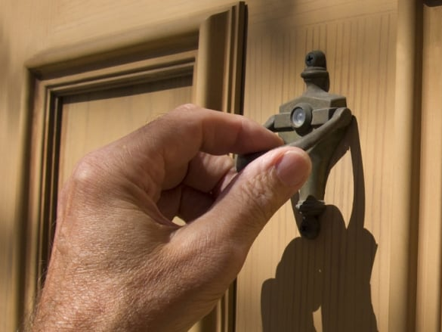
Rev 3:20
Here I am! I stand at the door and knock. If anyone hears my voice and opens the door, I will come in and eat with that person, and they with me.

