Slide 1
Seeking Social Status

Slide 3
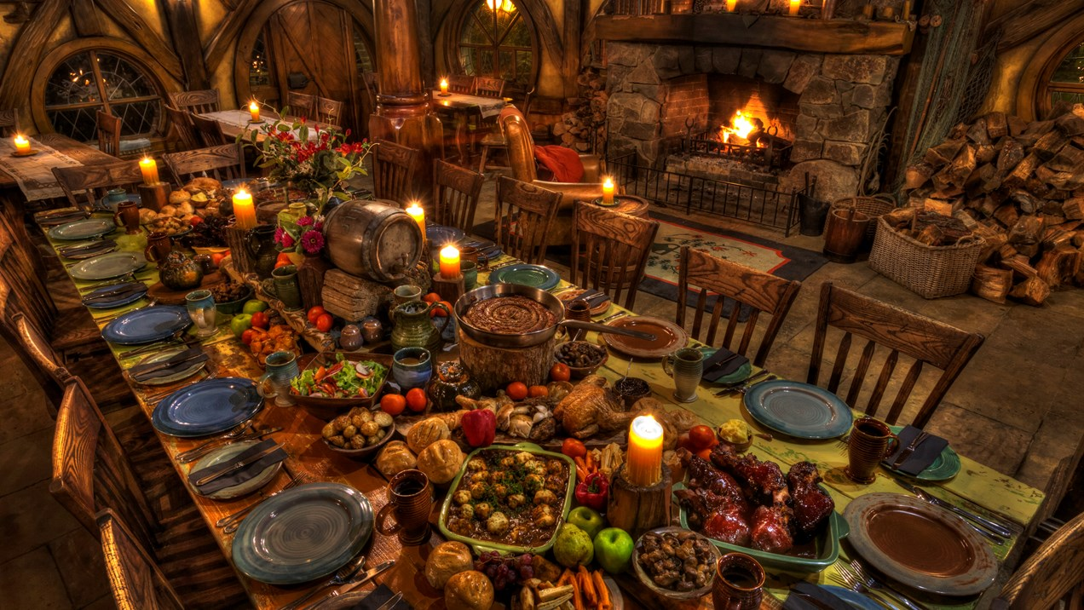

Slide 4
Luke 14:1-6
One Sabbath, when Jesus went to eat in the house of a prominent Pharisee, he was being carefully watched. ² There in front of him was a man suffering from dropsy. ³ Jesus asked the Pharisees and experts in the law, ‘Is it lawful to heal on the Sabbath or not?’ ⁴ But they remained silent. So taking hold of the man, he healed him and sent him away.
⁵ Then he asked them, ‘If one of you has a son or an ox that falls into a well on the Sabbath day, will you not immediately pull it out?’ ⁶ And they had nothing to say.

Slide 5
Vs 7-14
When he noticed how the guests picked the places of honour at the table, he told them this parable: 8 ‘When someone invites you to a wedding feast, do not take the place of honour, for a person more distinguished than you may have been invited. 9 If so, the host who invited both of you will come and say to you, “Give this person your seat.” Then, humiliated, you will have to take the least important place. 10 But when you are invited, take the lowest place, so that when your host comes, he will say to you, “Friend, move up to a better place.” Then you will be honoured in the presence of all the other guests. 11 For all those who exalt themselves will be humbled, and those who humble themselves will be exalted.’

Slide 6
‘When you give a luncheon or dinner, do not invite your friends, your brothers or sisters, your relatives, or your rich neighbours; if you do, they may invite you back and so you will be repaid. ¹³ But when you give a banquet, invite the poor, the crippled, the lame, the blind, ¹⁴ and you will be blessed. Although they cannot repay you, you will be repaid at the resurrection of the righteous.’

Slide 7
Vs 15-24
When one of those at the table with him heard this, he said to Jesus, ‘Blessed is the one who will eat at the feast in the kingdom of God.’
¹⁶ Jesus replied: ‘A certain man was preparing a great banquet and invited many guests. ¹⁷ At the time of the banquet he sent his servant to tell those who had been invited, “Come, for everything is now ready.”¹⁸ ‘But they all alike began to make excuses. The first said, “I have just bought a field, and I must go and see it. Please excuse me.”¹⁹ ‘Another said, “I have just bought five yoke of oxen, and I’m on my way to try them out. Please excuse me.”
²⁰ ‘Still another said, “I have just got married, so I can’t come.”

Slide 8
The servant came back and reported this to his master.
Then the owner of the house became angry and ordered his servant, “Go out quickly into the streets and alleys of the town and bring in the poor, the crippled, the blind and the lame.”
²² ‘“Sir,” the servant said, “what you ordered has been done, but there is still room.”
²³ ‘Then the master told his servant, “Go out to the roads and country lanes and make them come in, so that my house will be full. ²⁴ I tell you, not one of those men who were invited will get a taste of my banquet.”’

Slide 9
Luke 11:43 Woe to you Pharisees, because you love the most important seats in the synagogues and respectful greetings in the marketplaces.
Matthew 23:5-7 Everything they do is done for men to see: They make their phylacteries wide and the tassels on their garments long; they love the place of honour at banquets and the most important seats in the synagogues, they love to be greeted in the marketplaces and to have men call them ‘Rabbi’.
Status as Authorities on Law keeping
Jesus threatened their social status

Slide 10
Luke 14:1-6
One Sabbath, when Jesus went to eat in the house of a prominent Pharisee, he was being carefully watched. ² There in front of him was a man suffering from dropsy. ³ Jesus asked the Pharisees and experts in the law, ‘Is it lawful to heal on the Sabbath or not?’ ⁴ But they remained silent. So taking hold of the man, he healed him and sent him away.
⁵ Then he asked them, ‘If one of you has a son or an ox that falls into a well on the Sabbath day, will you not immediately pull it out?’ ⁶ And they had nothing to say.

Slide 11
Luke 14:1-6
One Sabbath, when Jesus went to eat in the house of a prominent Pharisee, he was being carefully watched. ² There in front of him was a man suffering from dropsy. ³ Jesus asked the Pharisees and experts in the law, ‘Is it lawful to heal on the Sabbath or not?’ ⁴ But they remained silent. So taking hold of the man, he healed him and sent him away.
⁵ Then he asked them, ‘If one of you has a son or an ox that falls into a well on the Sabbath day, will you not immediately pull it out?’ ⁶ And they had nothing to say.

Slide 12
Luke 14:1-6
One Sabbath, when Jesus went to eat in the house of a prominent Pharisee, he was being carefully watched. 2 There in front of him was a man suffering from dropsy. ³ Jesus asked the Pharisees and experts in the law, ‘Is it lawful to heal on the Sabbath or not?’ 4 But they remained silent. So taking hold of the man, he healed him and sent him away.
5 Then he asked them, ‘If one of you has a son or an ox that falls into a well on the Sabbath day, will you not immediately pull it out?’ ⁶ And they had nothing to say.

Slide 13
Luke 14:1-6
One Sabbath, when Jesus went to eat in the house of a prominent Pharisee, he was being carefully watched. 2 There in front of him was a man suffering from dropsy. 3 Jesus asked the Pharisees and experts in the law, ‘Is it lawful to heal on the Sabbath or not?’ 4 But they remained silent. So taking hold of the man, he healed him and sent him away.
5 Then he asked them, ‘If one of you has a son or an ox that falls into a well on the Sabbath day, will you not immediately pull it out?’ ⁶ And they had nothing to say.

Slide 14
1. Status Protection VS 1-6
Pharisees, who invited Jesus to table fellowship to discredit him to protect their social status, were left speechless after Jesus skillfully defended Sabbath healing as fulfillment of God’s saving purposes.
Those whose social status with others is threatened by Jesus’ disciple(s) will watch for opportunities to discredit said disciple(s) in order to protect their status with or over others.

Slide 15
What are some possible scenarios in which people may feel their social status with others is being diminished or threatened by Jesus’ disciples fulfilling God’s saving purposes?
What things could they try to do to protect or regain their influence?

Slide 16
Why did Jesus go to the dinner?

Slide 17
Vs 7-14 When he noticed how the guests picked the places of honour at the table, he told them this parable: 8 ‘When someone invites you to a wedding feast, do not take the place of honour, for a person more distinguished than you may have been invited. 9 If so, the host who invited both of you will come and say to you, “Give this person your seat.” Then, humiliated, you will have to take the least important place. 10 But when you are invited, take the lowest place, so that when your host comes, he will say to you, “Friend, move up to a better place.” Then you will be honoured in the presence of all the other guests. 11 For all those who exalt themselves will be humbled, and those who humble themselves will be exalted.
Invitations were only given after careful thought
Exclusive not inclusive gatherings where status increased or at least maintained

Slide 18
Vs 7-14 When he noticed how the guests picked the places of honour at the table, he told them this parable: 8 ‘When someone invites you to a wedding feast, do not take the place of honour, for a person more distinguished than you may have been invited. 9 If so, the host who invited both of you will come and say to you, “Give this person your seat.” Then, humiliated, you will have to take the least important place. 10 But when you are invited, take the lowest place, so that when your host comes, he will say to you, “Friend, move up to a better place.” Then you will be honoured in the presence of all the other guests. 11 For all those who exalt themselves will be humbled, and those who humble themselves will be exalted.

Slide 19
Vs 7-14 When he noticed how the guests picked the places of honour at the table, he told them this parable: 8 ‘When someone invites you to a wedding feast, do not take the place of honour, for a person more distinguished than you may have been invited. 9 If so, the host who invited both of you will come and say to you, “Give this person your seat.” Then, humiliated, you will have to take the least important place. 10 But when you are invited, take the lowest place, so that when your host comes, he will say to you, “Friend, move up to a better place.” Then you will be honoured in the presence of all the other guests. 11 For all those who exalt themselves will be humbled, and those who humble themselves will be exalted.
Reversal of status -Simeon Luke 2

Slide 20
‘When you give a luncheon or dinner, do not invite your friends, your brothers or sisters, your relatives, or your rich neighbours; if you do, they may invite you back and so you will be repaid. ¹³ But when you give a banquet, invite the poor, the crippled, the lame, the blind, ¹⁴ and you will be blessed. Although they cannot repay you, you will be repaid at the resurrection of the righteous.’
Kingdom of God dining etiquette in response to God’s mercy
Invitation of those without any social currency
Abandonment of seeking honour from men to fulfill mission
Loftier honour/status bestowed by God

Slide 21
2. Status Promotion VS 7-14
Jesus taught the posturing Pharisees that heavenly honour awaits those who, in response to the good news, abandon seeking worldly status to become socially inclusive (for the Gospel’s sake).
Pattern for disciple-making
Jesus’ disciples abandon divisive social posturing to actively engage with those who have no social currency knowing God will bestow a much loftier enduring honour.

Slide 22
Who in the community around this church has little social currency that we could be proactively engaging for the Gospel’s sake?
What about those who have social currency?
2 Peter 3:9 The Lord is not slow in keeping his promise, as some understand slowness. Instead he is patient with you, not wanting anyone to perish, but everyone to come to repentance.

Slide 23
2. Status Promotion VS 7-14
Jesus taught the posturing Pharisees that heavenly honour awaits those who, in response to the good news, abandon seeking worldly status to become socially inclusive (for the Gospel’s sake).
Pursuit of worldly status keeps people from finding the Narrow door
Invite people to abandon posturing for worldly status

Slide 24
2. Status Promotion VS 7-14
Jesus taught the posturing Pharisees that heavenly honour awaits those who, in response to the good news, abandon seeking worldly status to become socially inclusive (for the Gospel’s sake).
Given the opportunity, Jesus’ disciples seek to redirect those caught up in social status seeking towards seeking the loftier status God gives.
After gaining some trust with those caught up in the pursuit of worldly status, how would you challenge them to abandon that pursuit for the honour God bestows in Christ?

Slide 25
Mark 8:36
‘What good is it for someone to gain the whole world, yet forfeit their soul?’
1 Cor. 1:26
Brothers and sisters, think of what you were when you were called. Not many of you were wise by human standards; not many were influential; not many were of noble birth.

Slide 26
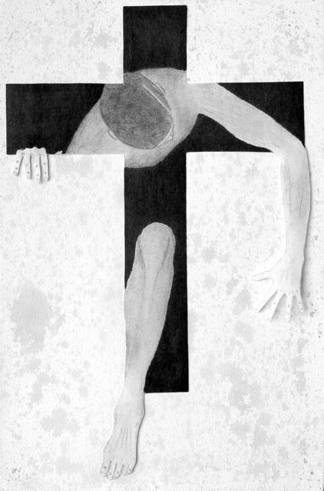
Matthew 19:24
‘Again I tell you, it is easier for a camel to go through the eye of a needle than for someone who is rich to enter the kingdom of God.’

Slide 28
Vs 15-24
When one of those at the table with him heard this, he said to Jesus, ‘Blessed is the one who will eat at the feast in the kingdom of God.’
¹⁶ Jesus replied: ‘A certain man was preparing a great banquet and invited many guests. ¹⁷ At the time of the banquet he sent his servant to tell those who had been invited, “Come, for everything is now ready.”¹⁸ ‘But they all alike began to make excuses. The first said, “I have just bought a field, and I must go and see it. Please excuse me.”¹⁹ ‘Another said, “I have just bought five yoke of oxen, and I’m on my way to try them out. Please excuse me.”
²⁰ ‘Still another said, “I have just got married, so I can’t come.”

Slide 29
Vs 15-24
When one of those at the table with him heard this, he said to Jesus, ‘Blessed is the one who will eat at the feast in the kingdom of God.’
¹⁶ Jesus replied: ‘A certain man was preparing a great banquet and invited many guests. ¹⁷ At the time of the banquet he sent his servant to tell those who had been invited, “Come, for everything is now ready.”¹⁸ ‘But they all alike began to make excuses. The first said, “I have just bought a field, and I must go and see it. Please excuse me.”¹⁹ ‘Another said, “I have just bought five yoke of oxen, and I’m on my way to try them out. Please excuse me.”
²⁰ ‘Still another said, “I have just got married, so I can’t come.”

Slide 30
Vs 15-24
When one of those at the table with him heard this, he said to Jesus, ‘Blessed is the one who will eat at the feast in the kingdom of God.’
¹⁶ Jesus replied: ‘A certain man was preparing a great banquet and invited many guests. ¹⁷ At the time of the banquet he sent his servant to tell those who had been invited, “Come, for everything is now ready.”¹⁸ ‘But they all alike began to make excuses. The first said, “I have just bought a field, and I must go and see it. Please excuse me.”¹⁹ ‘Another said, “I have just bought five yoke of oxen, and I’m on my way to try them out. Please excuse me.”
²⁰ ‘Still another said, “I have just got married, so I can’t come.”

Slide 31
The servant came back and reported this to his master.
Then the owner of the house became angry and ordered his servant, “Go out quickly into the streets and alleys of the town and bring in the poor, the crippled, the blind and the lame.”
²² ‘“Sir,” the servant said, “what you ordered has been done, but there is still room.”
²³ ‘Then the master told his servant, “Go out to the roads and country lanes and make them come in, so that my house will be full. ²⁴ I tell you, not one of those men who were invited will get a taste of my banquet.”’

Slide 32
The servant came back and reported this to his master.
Then the owner of the house became angry and ordered his servant, “Go out quickly into the streets and alleys of the town and bring in the poor, the crippled, the blind and the lame.”
²² ‘“Sir,” the servant said, “what you ordered has been done, but there is still room.”
²³ ‘Then the master told his servant, “Go out to the roads and country lanes and make them come in, so that my house will be full. ²⁴ I tell you, not one of those men who were invited will get a taste of my banquet.”’

Slide 33
The servant came back and reported this to his master.
Then the owner of the house became angry and ordered his servant, “Go out quickly into the streets and alleys of the town and bring in the poor, the crippled, the blind and the lame.”
22 ‘“Sir,” the servant said, “what you ordered has been done, but there is still room.”
23 ‘Then the master told his servant, “Go out to the roads and country lanes and make them come in, so that my house will be full. ²⁴ I tell you, not one of those men who were invited will get a taste of my banquet.”’
Parable of Kingdom of God?

Slide 34
2. Status Promotion VS 7-14
Jesus’ story tells of one who responds to his teaching to abandon social posturing and proactively embrace socially inclusive table fellowship, a fellowship social snobs would never participate in.
The fear of committing social suicide is a barrier status seekers must overcome in order to seek Jesus and become part of his inclusive community alongside social losers and outcasts.

Slide 35
Believers’ Roles
Thresholds to Cross
Prayer
Disinterest /Mistrust
Friendship
Trust Believer
Loving Service
Inviting
Curiosity
Sharing Testimony
Open to change
Explaining Gospel
Seeking after God
Answering questions
Call to Commitment
Entering Kingdom

Slide 36
Believers’ Roles
Thresholds to Cross
Prayer
Disinterest /Mistrust
Friendship
Trust Believer
Loving Service
Inviting
Curiosity
Sharing Testimony
Open to change
Explaining Gospel
Seeking after God
Answering questions
Call to Commitment
Entering Kingdom

Slide 37
Proactive social connections with those with little social currency, although creating an additional hurdle for socially elite seekers, is a non-negotiable requirement of making mature multiplying disciples.
Status seeking part of fallen human nature
Counter culture to inclusive nature of God’s Kingdom
What about us?

