Slide 1
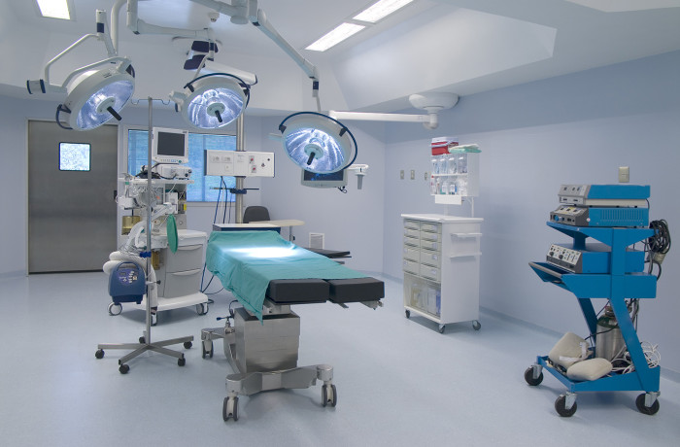

Slide 2

Salvation

Slide 3
Hebrews 10:19-22
19 Therefore, brothers and sisters, since we have confidence to enter the Most Holy Place by the blood of Jesus, 20 by a new and living way opened for us through the curtain, that is, his body, 21 and since we have a great priest over the house of God, 22 let us draw near to God with a sincere heart and with the full assurance that faith brings, having our hearts sprinkled to cleanse us from a guilty conscience and having our bodies washed with pure water.

Slide 4
Hebrews 4:14-16
14 Therefore, since we have a great high priest who has ascended into heaven,[a] Jesus the Son of God, let us hold firmly to the faith we profess. 15 For we do not have a high priest who is unable to empathize with our weaknesses, but we have one who has been tempted in every way, just as we are—yet he did not sin. 16 Let us then approach God’s throne of grace with confidence, so that we may receive mercy and find grace to help us in our time of need.

Slide 5
Hebrews 10:19-22
19 Therefore, brothers and sisters, since we have confidence to enter the Most Holy Place by the blood of Jesus, 20 by a new and living way opened for us through the curtain, that is, his body, 21 and since we have a great priest over the house of God, 22 let us draw near to God with a sincere heart and with the full assurance that faith brings, having our hearts sprinkled to cleanse us from a guilty conscience and having our bodies washed with pure water.

Slide 6
Salvation
Confidently Approaching God

Slide 7
Confidently Approaching God vs. 19-22
Through Jesus’ death, disciples of Jesus have gained unlimited access to God and therefore each disciple must confidently seek God in all things through the Word and prayer.

Slide 8
What are the signs that would reveal a Christian not approaching God with confidence?
Prayerlessness
Not Spending time in God’s Word

Slide 9
Christians agree prayer is important, but why is there this struggle with saturating their life in prayer?
Reality....
Prayer is an unnatural activity.
Ever since sin entered the world, every person has the inner struggle with naturally focusing on self-sufficiency and self- reliance.

Slide 10
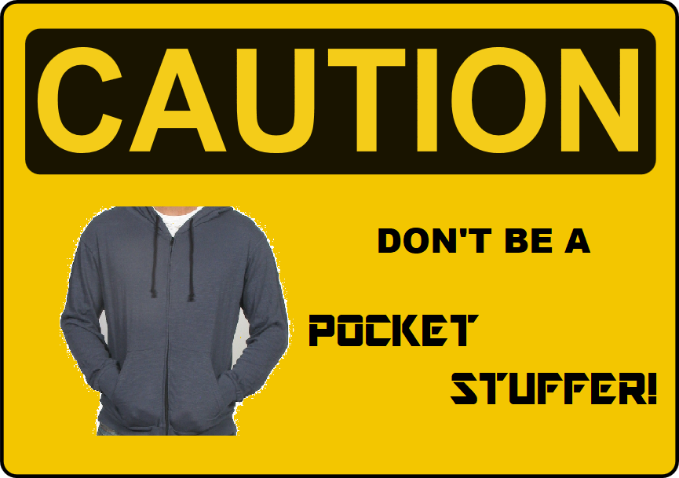
You will miss out on God releasing power into your life when you put your hands in your pockets and say, "Thanks, but no thanks. I can handle things on my own.

Slide 11
Side Effects to Prayerlessness
Feeling overwhelmed, overrun, beaten down, pushed around and defeated by a world operating with a take-no-prisoner’s approach.

Slide 12
A Church that Lacks Praying Together
Side Effects….
- Division (A church who prays together, stays together!)
Congregation feels overwhelmed, overrun,
beaten down, feeling defeated.
A lack of fruit
A lack of joy in serving
A lack of peace for the future, in relationships
… etc.

Slide 13
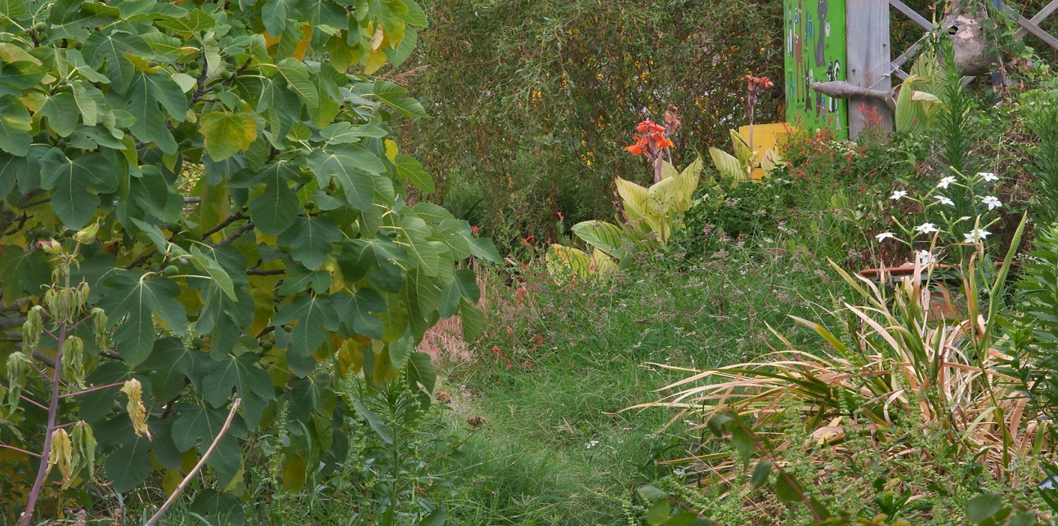

Personally
How worn is your path between you and God?
Corporately

Slide 14
Confidently Approaching God vs. 19-22
Through Jesus death we have unlimited access to God and therefore we must confidently seek God in all things (personally and corporately) through Word and prayer.

Slide 15
Hebrews 10:23
“Let us hold unswervingly to the hope we profess, for he who promised is faithful.”
“We have this hope as an anchor for the soul, firm and secure.”
Hebrews 6:19a

Slide 16
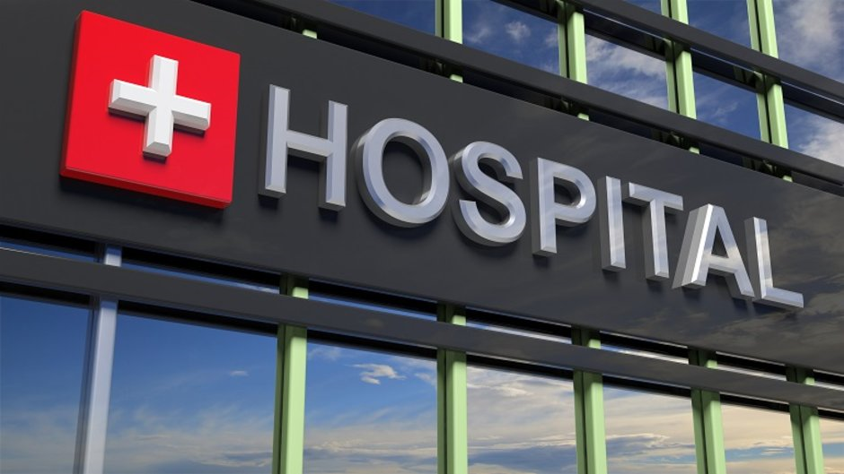
"They wouldn't send a teacher to work on nouns and adverbs with a dying boy, would they?"

Slide 17
Holding
On To
Hope
Salvation
Approaching
God with
Confidence

Slide 18
2. Holding on to Hope vs. 23
Since God is a promise keeping God, the church should hold firmly to the hope found in God’s promises.

Slide 19
What kind of things might we face in Hamilton that would try to pry us away from our confession of hope in Christ?
- Loss of relationships
Emotional battles: Doubt, fear, feeling incapable,
anxiety, worry…
- Circumstances
- Mistreatment because of our faith

Slide 20
According to what we have read so far in Hebrews chapter 10, what can cause our hope to be pried away?
If we lack confidence and stop approaching God

Slide 21
2. Holding on to Hope vs. 23
Since we can place our trust in God’s promises, we at Elliott Heights must firmly hold on to the hope that began when we first believed.

Slide 22
Hebrews 10:24-25
“And let us consider how we may spur one another on toward love and good deeds, 25 not giving up meeting together, as some are in the habit of doing, but encouraging one another—and all the more as you see the Day approaching.”

Slide 23
Hebrews 10:24-25
“And let us consider how we may spur one another on toward love and good deeds, 25 not giving up meeting together, as some are in the habit of doing, but encouraging one another—and all the more as you see the Day approaching.”

Slide 24
Hebrews 10:24-25
“And let us consider how we may spur one another on toward love and good deeds, 25 not giving up meeting together, as some are in the habit of doing, but encouraging one another—and all the more as you see the Day approaching.”

Slide 25
Hope that Sustains
Salvation
Loving the Church
Family
Approaches
God with
Confidence

Slide 26
3. Loving the Church Family vs. 24-25
Since God calls us to love one another, each disciple must intentionally love in ways that will spur the church on as a whole to love and do good deeds.

Slide 27
Application
Intentionally spurring on others to love and good deeds… what needs to happen for this to happen?
A) Choose to attend faithfully
1)Attending Sunday Service
2) Partaking in Wee groups or Growth Essential Classes
3) Attending corporate events

Slide 28
PRAYER RAISING BANQUET!!
Date: February 10th, 2019 Time: 5pm to 6:45pm
Child Care Will Be Provided!!

Slide 29
Date: February 23rd, 2019 Starting Time: 6:30pm

Slide 30


Slide 31


The Easter
Edition!!
You and Your Friends Have One Hour To Try To Escape By Using Logic and Riddles
Date: April 6th, 2019 One Hour Sessions can begin @ 2pm

Slide 32

Date: Sunday April 14th, 2019
Morning Service & Evening Service with Potluck

Slide 33
Either A June or a July Event

Slide 34
Application
Intentionally spurring on others to love and good deeds… what needs to happen for this to happen?
A) Choose to attend faithfully
1)Attending Sunday Service
2) Partaking in Wee groups or Growth Essential Classes
3) Attending corporate events
B) Approaching God for wisdom on how to spur on others
C) Being Intentional when the opportunities arise

Slide 35
3. Loving the Church Family vs. 24-25
Since God calls us to show love to one other, let us intentionally love in ways that will spur the church as a whole to love and good deeds.

Slide 36
Renewing My Commitment
This is my family of Jesus. It is composed of people just like me. It will be friendly if I am. It will do a great work if I work. It will be a house of prayer if I intentionally join others in prayer. It will make generous gifts to many causes if I am generous. It will bring others into its fellowship if I bring them. The gospel will be proclaimed if I proclaim it. Discipleship will take place if I choose to disciple and be discipled. Its seats will be filled if I fill them. It will be a church of loyalty and love, of faith and service, if I am loyal, love, believe and serve. With God’s help, I dedicate myself to joining my brothers and sisters in Christ to the task of being all these things that our Lord Jesus wants this family to be.

Slide 37
Main Idea:
Because of what Jesus did on the cross, let us stay committed to approaching God with confidence, holding on to the Hope God has given, and actively loving His church.

