Slide 1
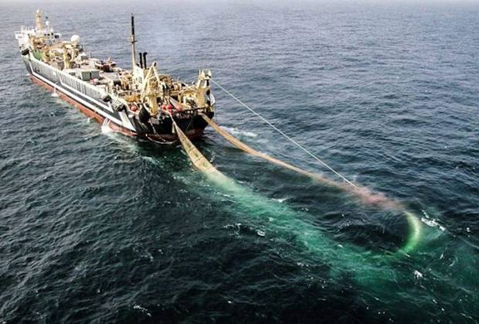

Slide 2


Slide 3
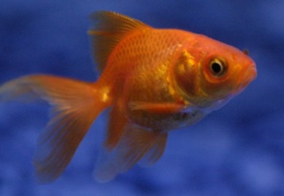

Slide 4
Have you met the required condition for being a disciple of Jesus?

Slide 5
Luke 14
25 Large crowds were travelling with Jesus, and turning to them he said:
26 ‘If anyone comes to me and does not hate father and mother, wife and children, brothers and sisters – yes, even their own life – such a person cannot be my disciple.
27 And whoever does not carry their cross and follow me cannot be my disciple.

Slide 6
Luke 14
25 Large crowds were travelling with Jesus, and turning to them he said:
26 ‘If anyone comes to me and does not hate father and mother, wife and children, brothers and sisters – yes, even their own life – such a person cannot be my disciple.
27 And whoever does not carry their cross and follow me cannot be my disciple.
Significance of extended family in Jesus’ day
Disavowal of primary allegiance to family/transfer allegiance to Jesus

Slide 7
Luke 14
25 Large crowds were travelling with Jesus, and turning to them he said:
26 ‘If anyone comes to me and does not hate father and mother, wife and children, brothers and sisters – yes, even their own life – such a person cannot be my disciple.
27 And whoever does not carry their cross and follow me cannot be my disciple.
Allegiance to self is a human thing
Disavowal of allegiance to self/transfer of allegiance to Jesus

Slide 8
Luke 14
25 Large crowds were travelling with Jesus, and turning to them he said:
26 ‘If anyone comes to me and does not hate father and mother, wife and children, brothers and sisters – yes, even their own life – such a person cannot be my disciple.
27 And whoever does not carry their cross and follow me cannot be my disciple.
Allegiance to Jesus’ mission

Slide 9
1. Transfer Allegiance to Jesus (25-27)
Those who transferred their primary allegiance to family (the societal norm of Jesus’ day) and self (a human thing) to Jesus and his mission could become Jesus’ disciples.
What are the perceived cons of transferring one’s allegiance to Jesus ?

Slide 10
1. Transfer Allegiance to Jesus (25-27)
Those who transferred their primary allegiance to family (the societal norm of Jesus’ day) and self (a human thing) to Jesus and his mission could become Jesus’ disciples.
What are the pros of transferring one’s allegiance to Jesus?

Slide 11
1. Transfer Allegiance to Jesus (25-27)
Those who transferred their primary allegiance to family (the societal norm of Jesus’ day) and self (a human thing) to Jesus and his mission could become Jesus’ disciples.
If it were possible to be a disciple of Jesus and not transfer allegiance to him and his mission, what would be the outcome?

Slide 12
1. Transfer Allegiance to Jesus (25-27)
Those who transferred their primary allegiance to family (the societal norm of Jesus’ day) and self (a human thing) to Jesus and his mission could become Jesus’ disciples.
Transfer of allegiance not intended to dishonour parents, forsake a marriage, or abandon one’s children . . . or harm us personally
Relativizing of obligations and commitments

Slide 13
Have you met Jesus’ condition for discipleship?
Have you transferred your allegiance to him?
• Ongoing challenge of the ever changing nature of life and life-roles . . .
Genuine disciples of Jesus transfer their allegiance to Jesus and his mission, an umbrella under which all other obligations and commitments of their ever changing lives are continually relativized.

Slide 14
Is there a commitment or obligation you need to take a fresh look at to make sure it is not threatening your primary allegiance to Jesus?
What criteria would you use to properly relativize existing or new commitments or obligations under you primary allegiance to Christ and his mission?

Slide 15
Jesus’ Discipleship Conditions
1. Transfer Allegiance to Jesus (25-27)
2. Transfer of Everything to Jesus (28-33)

Slide 16
28 ‘Suppose one of you wants to build a tower. Won’t you first sit down and estimate the cost to see if you have enough money to complete it? 29 For if you lay the foundation and are not able to finish it, everyone who sees it will ridicule you, 30 saying, “This person began to build and wasn’t able to finish.” 31 ‘Or suppose a king is about to go to war against another king. Won’t he first sit down and consider whether he is able with ten thousand men to oppose the one coming against him with twenty thousand? 32 If he is not able, he will send a delegation while the other is still a long way off and will ask for terms of peace.

Slide 17
28 ‘Suppose one of you wants to build a tower. Won’t you first sit down and estimate the cost to see if you have enough money to complete it? 29 For if you lay the foundation and are not able to finish it, everyone who sees it will ridicule you, 30 saying, “This person began to build and wasn’t able to finish.” 31 ‘Or suppose a king is about to go to war against another king. Won’t he first sit down and consider whether he is able with ten thousand men to oppose the one coming against him with twenty thousand? 32 If he is not able, he will send a delegation while the other is still a long way off and will ask for terms of peace.
Do you have what it takes to finish what you start?
Do you have what it takes to finish the journey of following Jesus?

Slide 18
33 In the same way, those of you who do not give up everything you have cannot be my disciples.
If we do not give up everything we will not be able to finish the journey as his disciple.
Sell everything you have and give it to the poor so you can join a monastery?
Give up everything that could interfere with your allegiance to Jesus?
Give up everything to the Lord . . .

Slide 19
2. Transfer of Everything to Jesus (25-27)
Those who transfer everything to Jesus (knowing those things are insufficient to finish the journey with Jesus) could become Jesus’ disciples.
• Relinquishing everything into Jesus’ hands; relinquish everything to his control . . . continually
Following Jesus requires continual transfer of control over everything to Jesus, knowing that with him at the wheel we will finish our life-journey with him.

Slide 20
What is the logic behind this command? Other than being a command, why is it a smart idea to transfer everything to Jesus’ control?
1 Cor. 6:19-20 You are not your own; you were bought at a price. Therefore honour God with your bodies.

Slide 21
What are all the different “every” things we have that make up everything?
We are just stewards of these “every” things. How do you determine what the Lord wants us to do with these things?

Slide 22



Believers’ Roles
Thresholds to Cross
Prayer
Disinterest /Mistrust
Friendship
Trust Believer
Loving Service
Inviting
Curiosity
Sharing Testimony
Open to change
Explaining Gospel
Seeking after God
Answering questions
Call to Commitment
Entering Kingdom

Slide 23
Have you transferred control of everything to the Lord Jesus?
Is there something that you are still hanging onto control of?

Slide 24
Jesus’ Discipleship Conditions
1. Transfer Allegiance to Jesus (25-27)
2. Transfer of Everything to Jesus (28-33)
What happens if one does not meet the criteria for being Jesus’ disciple?

Slide 25
Luke 14:
‘Salt is good, but if it loses its saltiness, how can it be made salty again? 35 It is fit neither for the soil nor for the manure heap; it is thrown out.
‘Whoever has ears to hear, let them hear.’
Salt that is no longer salt is not salt
Those who do not meet the criteria of discipleship are not Jesus’ disciples
Those who meet it are transformed to be ‘salty’

Slide 26
Luke 14:
‘Salt is good, but if it loses its saltiness, how can it be made salty again? 35 It is fit neither for the soil nor for the manure heap; it is thrown out.
‘Whoever has ears to hear, let them hear.’
Those who do not meet criteria to become Jesus’ disciples have a tragic end

Slide 27
Luke 14:
‘Salt is good, but if it loses its saltiness, how can it be made salty again? 35 It is fit neither for the soil nor for the manure heap; it is thrown out.
‘Whoever has ears to hear, let them hear.’
Jesus wanted those who were just familiar with him and his mission to escape the tragic end they were headed for

Slide 28
3. Transfer of Destiny (25-27)
Jesus wanted those familiar with him and his mission to meet the criteria of his discipleship so they would not have a tragic end.
By meeting Jesus’ discipleship criteria we become true disciples whose ending transfers from tragedy to the glory shared with him in his kingdom.

