Slide 1

Loneliness
Rejection
Failure

Slide 2
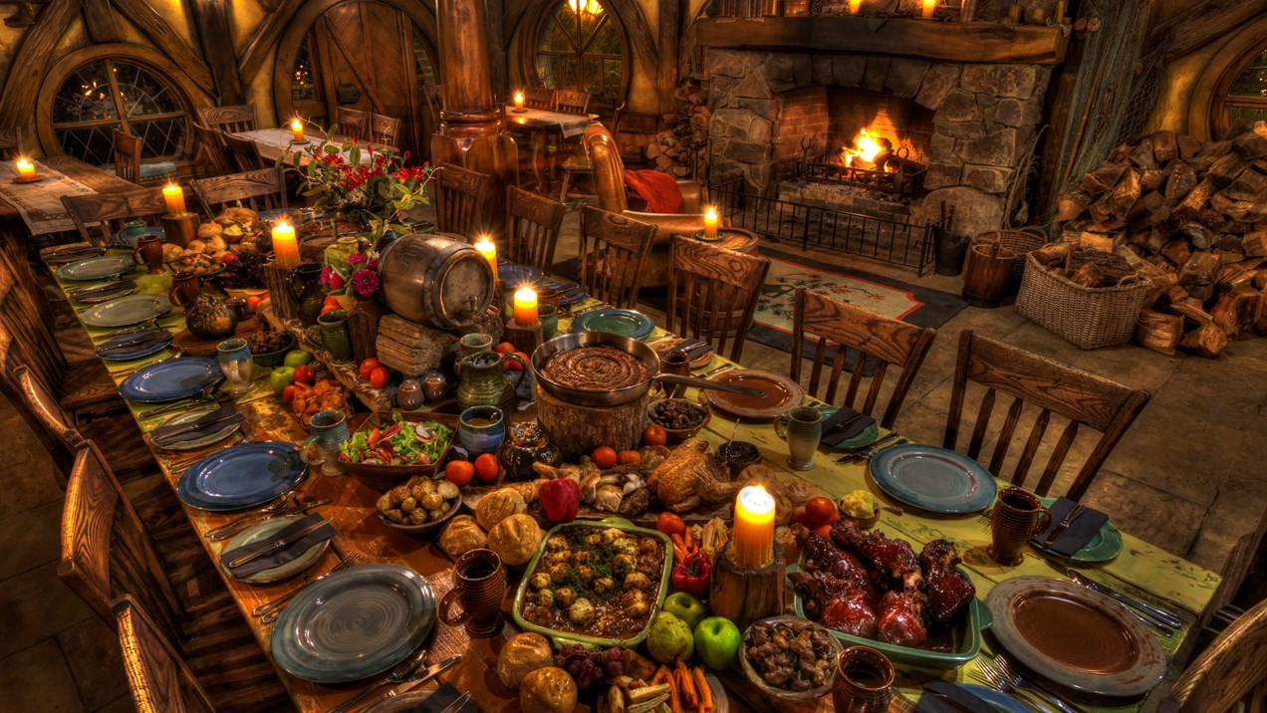
Luke 15
Now the tax collectors and sinners were all gathering round to hear Jesus. 2 But the Pharisees and the teachers of the law muttered, ‘This man welcomes sinners, and eats with them.’
Self-righteous prigs

Slide 3
3 Then Jesus told them this parable: 4 ‘Suppose one of you has a hundred sheep and loses one of them. Doesn’t he leave the ninety-nine in the open country and go after the lost sheep until he finds it? 5 And when he finds it, he joyfully puts it on his shoulders 6 and goes home. Then he calls his friends and neighbours together and says, “Rejoice with me; I have found my lost sheep.” 7 I tell you that in the same way there will be more rejoicing in heaven over one sinner who repents than over ninety-nine righteous people who do not need to repent.’

Slide 4
8 ‘Or suppose a woman has ten silver coins and loses one. Doesn’t she light a lamp, sweep the house and search carefully until she finds it? 9 And when she finds it, she calls her friends and neighbours together and says, “Rejoice with me; I have found my lost coin.” 10 In the same way, I tell you, there is rejoicing in the presence of the angels of God over one sinner who repents.’

Slide 5
11 Jesus continued: ‘There was a man who had two sons. 12 The younger one said to his father, “Father, give me my share of the estate.” So he divided his property between them.’
13 ‘Not long after that, the younger son got together all he had, set off for a distant country and there squandered his wealth in wild living. 14 After he had spent everything, there was a severe famine in that whole country, and he began to be in need. 15 So he went and hired himself out to a citizen of that country, who sent him to his fields to feed pigs. 16 He longed to fill his stomach with the pods that the pigs were eating, but no one gave him anything.’

Slide 6
17 ‘When he came to his senses, he said, “How many of my father’s hired servants have food to spare, and here I am starving to death! 18 I will set out and go back to my father and say to him: Father, I have sinned against heaven and against you. 19 I am no longer worthy to be called your son; make me like one of your hired servants.” 20 So he got up and went to his father.’

Slide 7
‘But while he was still a long way off, his father saw him and was filled with compassion for him; he ran to his son, threw his arms round him and kissed him.’
21 ‘The son said to him, “Father, I have sinned against heaven and against you. I am no longer worthy to be called your son.”
22 ‘But the father said to his servants, “Quick! Bring the best robe and put it on him. Put a ring on his finger and sandals on his feet. 23 Bring the fattened calf and kill it. Let’s have a feast and celebrate. 24 For this son of mine was dead and is alive again; he was lost and is found.” So they began to celebrate.’

Slide 8
God initiates the retrieval of the lost
‘Suppose one of you has a hundred sheep and loses one of them. Doesn’t he leave the ninety-nine in the open country and go after the lost sheep until he finds it? 5 And when he finds it, he joyfully puts it on his shoulders 6 and goes home.
Or suppose a woman has ten silver coins and loses one. Doesn’t she light a lamp, sweep the house and search carefully until she finds it?
‘But while he was still a long way off, his father saw him and was filled with compassion for him; he ran to his son, threw his arms round him and kissed him.’
Diligent and persistent effort to find the lost
Personal loss that is not accepted
Shameless watching, waiting , and running to embrace the one who had intentionally walked away

Slide 9
2. God Retrieves
God, driven by his desire to have the lost returned to him, initiates a relentless and shameless search to find them and bring them home.
God relentlessly and shamelessly sought _______ out, driven by his desire to get _________ back home with him.
God wanted me
God does the heavy lifting in retrieving the one he has lost and must have back when as Jesus’ disciples we respond to his initiating prompt to find the lost.
God did all the heavy lifting to retrieve me

Slide 10
John 6:44
‘No one can come to me unless the Father who sent me draws them.’

Slide 11
God Retrieves
God Restores

Slide 12
. . . Father, I have sinned against heaven and against you.
19 I am no longer worthy to be called your son; make me like one of your hired servants.” . . . ‘his father saw him and was filled with compassion for him; he ran to his son, threw his arms round him and kissed him. 21 ‘The son said to him, “Father, I have sinned against heaven and against you. I am no longer worthy to be called your son.”
22 ‘But the father said to his servants, “Quick! Bring the best robe and put it on him. Put a ring on his finger and sandals on his feet. 23 Bring the fattened calf and kill it. Let’s have a feast and celebrate. 24 For this son of mine was dead and is alive again; he was lost and is found.” So they began to celebrate.

Slide 13
. . . Father, I have sinned against heaven and against you.
19 I am no longer worthy to be called your son; make me like one of your hired servants.” . . . ‘his father saw him and was filled with compassion for him; he ran to his son, threw his arms round him and kissed him. 21 ‘The son said to him, “Father, I have sinned against heaven and against you. I am no longer worthy to be called your son.”
22 ‘But the father said to his servants, “Quick! Bring the best robe and put it on him. Put a ring on his finger and sandals on his feet. 23 Bring the fattened calf and kill it. Let’s have a feast and celebrate. 24 For this son of mine was dead and is alive again; he was lost and is found.” So they began to celebrate.

Slide 14
. . . Father, I have sinned against heaven and against you.
19 I am no longer worthy to be called your son; make me like one of your hired servants.” . . . ‘his father saw him and was filled with compassion for him; he ran to his son, threw his arms round him and kissed him. 21 ‘The son said to him, “Father, I have sinned against heaven and against you. I am no longer worthy to be called your son.”
22 ‘But the father said to his servants, “Quick! Bring the best robe and put it on him. Put a ring on his finger and sandals on his feet. 23 Bring the fattened calf and kill it. Let’s have a feast and celebrate. 24 For this son of mine was dead and is alive again; he was lost and is found.” So they began to celebrate.

Slide 15
3. God Restores
God’s love is only satisfied when those he has retrieved from being dead in sin are restored to full status as his children who he addresses as ‘my child’.
Whether _______ was a self-righteous prig, a silly wandering sheep, a coin ignorant of being lost, or had willfully turned from God, he fully restored _____as his beloved child.
I am God’s beloved child with full family privileges

Slide 16
1st John 3:1 ‘See what great love the Father has lavished on us, that we should be called children of God! And that is what we are!’
What are the benefits of being the Heavenly Father’s child?

Slide 17
God Retrieves
God Restores
God Rejoices

Slide 18
Jesus saw his dinner parties as a reflection of heaven’s joy over repentant sinners
“Rejoice with me; I have found my lost sheep.” 7 I tell you that in the same way there will be more rejoicing in heaven over one sinner who repents than over ninety-nine (self) righteous people who do not need to repent.
“Rejoice with me; I have found my lost coin.” 10 In the same way, I tell you, there is rejoicing in the presence of the angels of God over one sinner who repents.’
Let’s have a feast and celebrate. 24 For this son of mine was dead and is alive again; he was lost and is found.”

Slide 19
Jesus saw his dinner parties as a reflection of heaven’s joy over repentant sinners
“Rejoice with me; I have found my lost sheep.” 7 I tell you that in the same way there will be more rejoicing in heaven over one sinner who repents than over ninety-nine (self) righteous people who do not need to repent.
“Rejoice with me; I have found my lost coin.” 10 In the same way, I tell you, there is rejoicing in the presence of the angels of God over one sinner who repents.’
Let’s have a feast and celebrate. 24 For this son of mine was dead and is alive again; he was lost and is found.”

Slide 20
Jesus saw his dinner parties as a reflection of heaven’s joy over repentant sinners
“Rejoice with me; I have found my lost sheep.” 7 I tell you that in the same way there will be more rejoicing in heaven over one sinner who repents than over ninety-nine (self) righteous people who do not need to repent.
“Rejoice with me; I have found my lost coin.” 10 In the same way, I tell you, there is rejoicing in the presence of the angels of God over one sinner who repents.’
Let’s have a feast and celebrate. 24 For this son of mine was dead and is alive again; he was lost and is found.”

Slide 21
4. God Rejoices
God proudly calls upon all heaven to share in his joy of having his beloved children back from sin’s death grip, back home into his arms.
God has to rejoice over his children’s return home
God calls others to share in his joy to amplify that joy
God sings over _______ with Joy, proudly calling on all to join in his joy of having _______ back home with him as his beloved child.

Slide 22
Zephaniah 3:17
‘The Lord your God is with you, the Mighty Warrior who saves. He will take great delight in you; in his love he will no longer rebuke you, but will rejoice over you with singing.’
God throws a party for me out of joy

Slide 23
God Retrieves
God Restores
God Rejoices
God Requests (Pleads)

Slide 24
25 ‘Meanwhile, the elder son was in the field. When he came near the house, he heard music and dancing. 26 So he called one of the servants and asked him what was going on. 27 “Your brother has come,” he replied, “and your father has killed the fattened calf because he has him back safe and sound.”
28 ‘The elder brother became angry and refused to go in.

Slide 25
So his father went out and pleaded with him.
29 But he answered his father, “Look! All these years I’ve been slaving for you and never disobeyed your orders. Yet you never gave me even a young goat so I could celebrate with my friends. 30 But when this son of yours who has squandered your property with prostitutes comes home, you kill the fattened calf for him!”
31 ‘“My son,” the father said, “you are always with me, and everything I have is yours. 32 But we had to celebrate and be glad, because this brother of yours was dead and is alive again; he was lost and is found.”’

Slide 26
So his father went out and pleaded with him.
29 But he answered his father, “Look! All these years I’ve been slaving for you and never disobeyed your orders. Yet you never gave me even a young goat so I could celebrate with my friends. 30 But when this son of yours who has squandered your property with prostitutes comes home, you kill the fattened calf for him!”
31 ‘“My son,” the father said, “you are always with me, and everything I have is yours. 32 But we had to celebrate and be glad, because this brother of yours was dead and is alive again; he was lost and is found.”’

Slide 27
So his father went out and pleaded with him.
29 But he answered his father, “Look! All these years I’ve been slaving for you and never disobeyed your orders. Yet you never gave me even a young goat so I could celebrate with my friends. 30 But when this son of yours who has squandered your property with prostitutes comes home, you kill the fattened calf for him!”
31 ‘“My son,” the father said, “you are always with me, and everything I have is yours. 32 But we had to celebrate and be glad, because this brother of yours was dead and is alive again; he was lost and is found.”’
The Pharisees are represented by the elder son
Ache of God’s heart for them to join the party too

Slide 28
5. God Requests/Pleads
Although God initiates his relentless pursuit to retrieve what he has lost, rather than forcing them he instead pleads with an aching heart for them to willingly ‘come home’.
Response to the Father’s pleading?
Father God, whose heart aches for his lost child ______, pleads with _______to respond to his desire and love for _____ , to make his joy complete by coming home.
God pleads for ________ to respond to his love

Slide 29
What is your response to God’s heart for you?

Slide 30
Sheep
Coin
Prodigal
Prig
What is your response to God’s heart for you?

Slide 31
Summary:
God’s heart is for us; he wants to retrieve us from sin to restore us as his children because of his love for us and the joy it brings him.
‘You are mine’
‘You are my beloved child’
‘You make me sing with joy’

