Slide 1
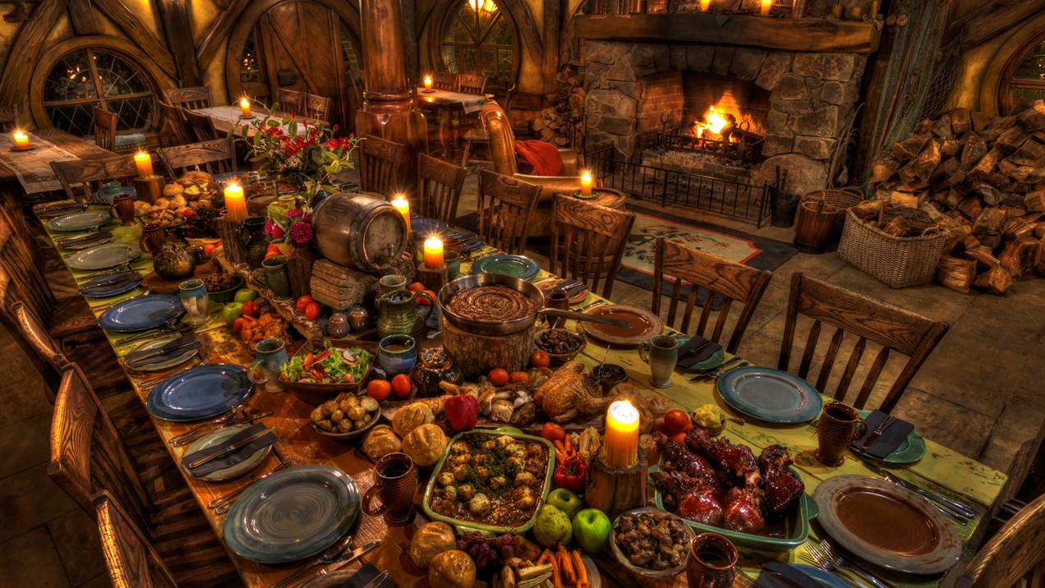
Luke 15
God’s heart is for us; he wanted to retrieve us from sin to restore us as his children because of his love for us and the joy it brought him.

Slide 2
Luke 15
God’s heart is for us; he wanted to retrieve us from sin to restore us as his children because of his love for us and the joy it brought him.
‘You are mine’
‘You are my beloved child’
‘You make me sing with joy’

Slide 3
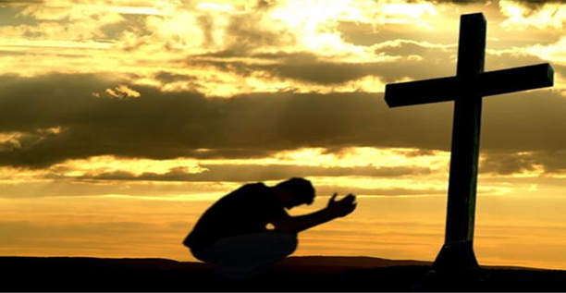
God’s heart for us should inspire us to continue to give him cause to sing over us with Joy
Scripturally
Shrewd
Stewards

Slide 4
Luke 16
Jesus told his disciples:
‘There was a rich man whose manager was accused of wasting his possessions. 2 So he called him in and asked him, “What is this I hear about you? Give an account of your management, because you cannot be manager any longer.”
3 ‘The manager said to himself, “What shall I do now? My master is taking away my job. I’m not strong enough to dig, and I’m ashamed to beg – 4 I know what I’ll do so that, when I lose my job here, people will welcome me into their houses.”

Slide 5
5 ‘So he called in each one of his master’s debtors.
He asked the first, “How much do you owe my master?”
6 ‘“Three thousand litres of olive oil,” he replied. ‘The manager told him, “Take your bill, sit down quickly, and make it fifteen hundred.” 7 ‘Then he asked the second, “And how much do you owe?” ‘“Thirty tons of wheat,” he replied. ‘He told him, “Take your bill and make it twenty-four.” 8 ‘The master commended the dishonest manager because he had acted shrewdly.
The manager shrewdly used his last moments of stewardship to indebt the master's debtors to himself so they would have to give him a roof over his head.

Slide 6
For the people of this world are more shrewd in dealing with their own kind than are the people of the light. 9 I tell you, use worldly wealth to gain friends for yourselves, so that when it is gone, you will be welcomed into eternal dwellings.
Shrewd children of a faithless and wicked age understood how patronage worked and used it to their own benefit . . . . to be invited into others’ earthly homes to live
Children of God had a way to go in shrewdly dealing with others in using worldly wealth
Luke 6:35 (giving to enemies); 12:33 (giving to poor); 14:12-14 (inviting those who cannot repay)

Slide 7
For the people of this world are more shrewd in dealing with their own kind than are the people of the light. 9 I tell you, use worldly wealth to gain friends for yourselves, so that when it is gone, you will be welcomed into eternal dwellings.
Friends who welcome us into eternal dwellings

Slide 8
1. Be Shrewd Vs 1-9
God’s children should be shrewd like unbelievers; although rather than using temporal wealth to indebt others to themselves, they shrewdly use it to make friends who will welcome them into heaven.
In response to God’s retrieval, restoration and rejoicing over us as his children, we should shrewdly use temporal wealth to make friends who will welcome us into God’s home.

Slide 9
What are some examples of shrewd/wise no-strings-attached giving that makes bridges for the Gospel?
What would be some examples of distribution of wealth that are unlikely to become a bridge for the Gospel?

Slide 10


Slide 11
10 ‘Whoever can be trusted with very little can also be trusted with much, and whoever is dishonest with very little will also be dishonest with much. 11 So if you have not been trustworthy in handling worldly wealth, who will trust you with true riches? 12 And if you have not been trustworthy with someone else’s property, who will give you property of your own?

Slide 12
10 ‘Whoever can be trusted with very little can also be trusted with much, and whoever is dishonest with very little will also be dishonest with much. 11 So if you have not been trustworthy in handling worldly wealth, who will trust you with true riches? 12 And if you have not been trustworthy with someone else’s property, who will give you property of your own?
First you must be faithful in stewardship of worldly wealth, then you can be given heavenly riches to steward

Slide 13
Besides material wealth, what other things could be considered earthly wealth that God has allotted us that we need to steward properly (fulfill his saving purposes) before we are granted a stewardship over true riches?
What things would qualify as true or heavenly riches that faithful stewards are granted stewardship of?

Slide 14
13 ‘No one can serve two masters. Either you will hate the one and love the other, or you will be devoted to the one and despise the other. You cannot serve both God and Money.’
To serve God, God’s children must control money to make it serve God’s purposes
What could be some signs that money is ruling someone?

Slide 15
2. Be Stewards Vs 10-13
Although God’s children cannot serve God and worldly wealth, they use wealth to serve God by stewarding it to fulfill his saving purposes, readying themselves for stewarding true heavenly wealth.
God’s children, who faithfully steward the worldly wealth they are allotted to serve God’s saving purposes, are rewarded with a stewardship of true heavenly riches.
Our incentive to be a faithful steward over earthly inventory of wealth

Slide 16
1. Be Shrewd
2. Be Stewards
3. Be Scriptural

Slide 17
3. Be Scriptural Vs 14-31
These verses are a message to the Pharisees, who were not shrewd stewards of the earthly wealth God had given them, who allowed wealth to control them rather than controlling it for God’s saving purposes. They were all about gaining status.
Pharisees wrongly thought they were righteous, that God would receive them into heaven as a result of their law keeping; keeping based on misinterpretation of the purpose of the Law, its specific components, and emphasis.
Their misinterpretation of the Law and prophets blinded them to Jesus being the Scripture’s fulfillment.

Slide 18
14 The Pharisees, who loved money, heard all this and were sneering at Jesus. 15 He said to them, ‘You are the ones who justify yourselves in the eyes of others, but God knows your hearts. What people value highly is detestable in God’s sight. 16 ‘The Law and the Prophets were proclaimed until John. Since that time, the good news of the kingdom of God is being preached, and everyone is forcing their way into it. 17 It is easier for heaven and earth to disappear than for the least stroke of a pen to drop out of the Law. 18 ‘Anyone who divorces his wife and marries another woman commits adultery, and the man who marries a divorced woman commits adultery.

Slide 19
14 The Pharisees, who loved money, heard all this and were sneering at Jesus. 15 He said to them, ‘You are the ones who justify yourselves in the eyes of others, but God knows your hearts. What people value highly is detestable in God’s sight. 16 ‘The Law and the Prophets were proclaimed until John. Since that time, the good news of the kingdom of God is being preached, and everyone is forcing their way into it. 17 It is easier for heaven and earth to disappear than for the least stroke of a pen to drop out of the Law. 18 ‘Anyone who divorces his wife and marries another woman commits adultery, and the man who marries a divorced woman commits adultery.

Slide 20
14 The Pharisees, who loved money, heard all this and were sneering at Jesus. 15 He said to them, ‘You are the ones who justify yourselves in the eyes of others, but God knows your hearts. What people value highly is detestable in God’s sight. 16 ‘The Law and the Prophets were proclaimed until John. Since that time, the good news of the kingdom of God is being preached, and everyone is forcing their way into it. 17 It is easier for heaven and earth to disappear than for the least stroke of a pen to drop out of the Law. 18 ‘Anyone who divorces his wife and marries another woman commits adultery, and the man who marries a divorced woman commits adultery.

Slide 21
14 The Pharisees, who loved money, heard all this and were sneering at Jesus. 15 He said to them, ‘You are the ones who justify yourselves in the eyes of others, but God knows your hearts. What people value highly is detestable in God’s sight. 16 ‘The Law and the Prophets were proclaimed until John. Since that time, the good news of the kingdom of God is being preached, and everyone is forcing their way into it. 17 It is easier for heaven and earth to disappear than for the least stroke of a pen to drop out of the Law. 18 ‘Anyone who divorces his wife and marries another woman commits adultery, and the man who marries a divorced woman commits adultery.

Slide 22
14 The Pharisees, who loved money, heard all this and were sneering at Jesus. 15 He said to them, ‘You are the ones who justify yourselves in the eyes of others, but God knows your hearts. What people value highly is detestable in God’s sight. 16 ‘The Law and the Prophets were proclaimed until John. Since that time, the good news of the kingdom of God is being preached, and everyone is forcing their way into it. 17 It is easier for heaven and earth to disappear than for the least stroke of a pen to drop out of the Law. 18 ‘Anyone who divorces his wife and marries another woman commits adultery, and the man who marries a divorced woman commits adultery.

Slide 23
Divorce papers were to be given to wives who were physically abused or were denied conjugal rights to have children or basic physical need fulfillment
Death penalty, not divorce, is how you dealt with sexual marital unfaithfulness
Husband could divorce if found something unseemly about his wife
Divorce granted so women could escape being tied to such men
Remarriage was allowed and expected; with the exception they could not marry a priest. Priests were only allowed to marry virgins

Slide 24
Many Pharisees held to divorce for any reason as a means to get rid of the wife of their youth to marry another younger woman they had been lusting after.
They thought they could avoid the guilt of adultery.

Slide 25
14 The Pharisees, who loved money, heard all this and were sneering at Jesus. 15 He said to them, ‘You are the ones who justify yourselves in the eyes of others, but God knows your hearts. What people value highly is detestable in God’s sight. 16 ‘The Law and the Prophets were proclaimed until John. Since that time, the good news of the kingdom of God is being preached, and everyone is forcing their way into it. 17 It is easier for heaven and earth to disappear than for the least stroke of a pen to drop out of the Law. 18 ‘Anyone who divorces his wife and marries another woman commits adultery, and the man who marries a divorced woman commits adultery.

Slide 26
14 The Pharisees, who loved money, heard all this and were sneering at Jesus. 15 He said to them, ‘You are the ones who justify yourselves in the eyes of others, but God knows your hearts. What people value highly is detestable in God’s sight. 16 ‘The Law and the Prophets were proclaimed until John. Since that time, the good news of the kingdom of God is being preached, and everyone is forcing their way into it. 17 It is easier for heaven and earth to disappear than for the least stroke of a pen to drop out of the Law. 18 ‘Anyone who divorces his wife and marries another woman commits adultery, and the man who marries a divorced woman commits adultery.

Slide 27
14 The Pharisees, who loved money, heard all this and were sneering at Jesus. 15 He said to them, ‘You are the ones who justify yourselves in the eyes of others, but God knows your hearts. What people value highly is detestable in God’s sight. 16 ‘The Law and the Prophets were proclaimed until John. Since that time, the good news of the kingdom of God is being preached, and everyone is forcing their way into it. 17 It is easier for heaven and earth to disappear than for the least stroke of a pen to drop out of the Law. 18 ‘Anyone who divorces his wife and marries another woman commits adultery, and the man who marries a divorced woman commits adultery.

Slide 28
Gospel and ministry of Jesus illuminates the other Scriptures; particularly Jesus’ focus on love for neighbour
Stewardship of marriage; no-strings-attached love
Pharisees violated ‘love for neighbour’ not only with marriage but also with the poor

Slide 29
19 ‘There was a rich man who was dressed in purple and fine linen and lived in luxury every day. 20 At his gate was laid a beggar named Lazarus, covered with sores 21 and longing to eat what fell from the rich man’s table. Even the dogs came and licked his sores.
22 ‘The time came when the beggar died and the angels carried him to Abraham’s side. The rich man also died and was buried. 23 In Hell, where he was in torment, he looked up and saw Abraham far away, with Lazarus by his side.
24 So he called to him, “Father Abraham, have pity on me and send Lazarus to dip the tip of his finger in water and cool my tongue, because I am in agony in this fire.”

Slide 30
25 ‘But Abraham replied, “Son, remember that in your lifetime you received your good things, while Lazarus received bad things, but now he is comforted here and you are in agony. 26 And besides all this, between us and you a great chasm has been set in place, so that those who want to go from here to you cannot, nor can anyone cross over from there to us.”
27 ‘He answered, “Then I beg you, father, send Lazarus to my family, 28 for I have five brothers. Let him warn them, so that they will not also come to this place of torment.”
29 ‘Abraham replied, “They have Moses and the Prophets; let them listen to them.”

Slide 31
30 ‘“No, father Abraham,” he said, “but if someone from the dead goes to them, they will repent.”
31 ‘He said to him, “If they do not listen to Moses and the Prophets, they will not be convinced even if someone rises from the dead.”’
After Christ’s resurrection and fulfillment of the Scriptures, many still would not get it

Slide 32
3. Be Scriptural Vs 14-31
By not interpreting Scriptures in light of Jesus’ fulfilling saving ministry’s focus on love, Pharisees blindly justified their despicable consumption of wealth intended for the poor, destining themselves to hell.
Interpret and apply Scripture in light of the Lord Jesus’ fulfilling saving ministry and his focus on ‘love your neighbour’ and you are sure to be a shrewd steward.

Slide 33


Slide 34
God’s heart for us should inspire us to continue to give him cause to sing over us with Joy
Scripturally
Shrewd
Stewards

