Slide 1
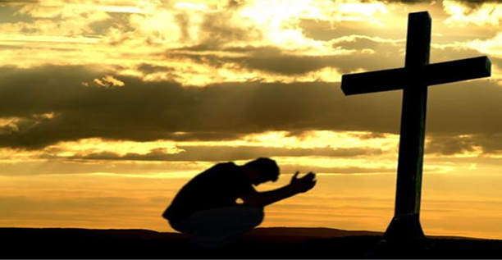
Titus 2:11-13 For the grace of God has appeared that offers salvation to all people. It teaches us to say ‘No’ to ungodliness and worldly passions, and to live self-controlled, upright and godly lives in this present age, while we wait for the blessed hope – the appearing of the glory of our great God and Saviour, Jesus Christ.
1 Cor. 10:13 No temptation has overtaken you except what is common to mankind. And God is faithful; he will not let you be tempted beyond what you can bear. But when you are tempted, he will also provide a way out so that you can endure it.
S
I
N

Slide 2
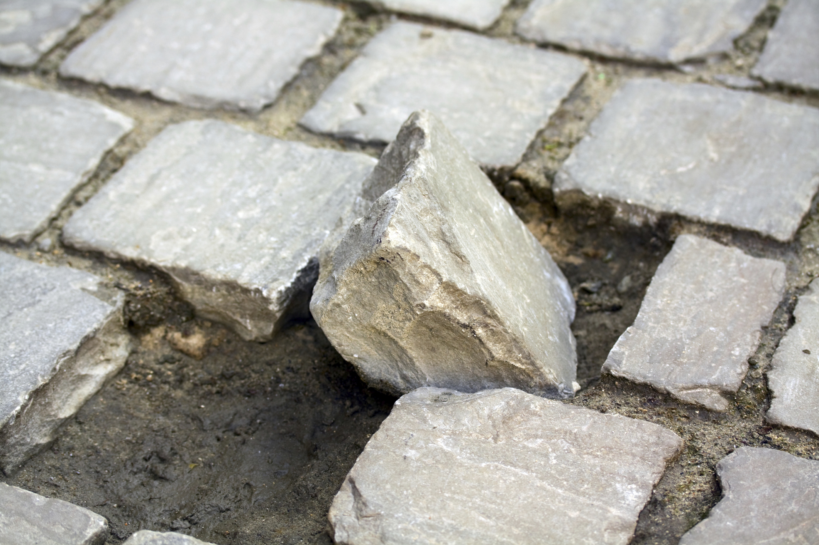
S
I
N

Slide 3
Luke 17
Jesus said to his disciples: ‘Things that cause people to stumble (sin) are bound to come, . . .
1st John 1:8-9 If we claim to be without sin, we deceive ourselves and the truth is not in us. If we confess our sins, he is faithful and just and will forgive us our sins and purify us from all unrighteousness.

Slide 4

Inevitable Stumbling Stones

Slide 5
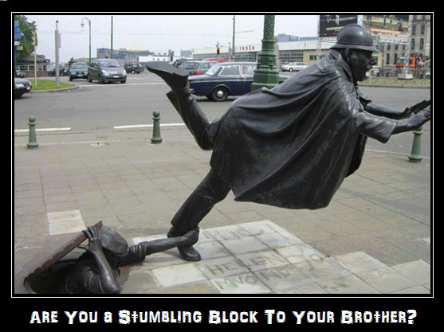
Luke 17: Jesus said to his disciples: ‘Things that cause people to stumble (sin) are bound to come, but woe to that person through whom they come. 2 It would be better for him to be thrown into the sea with a millstone tied round his neck than for him to cause one of these little ones to stumble. 3 So watch yourselves.
Guilty stumbling stones who cause disciples to stumble
Guilt and Fate of unrepentant Pharisees in parable of rich man and Lazarus
One thing to inevitably stumble into sin and entirely a different one to be the stumbling stone

Slide 6
Luke 17: Jesus said to his disciples: ‘Things that cause people to stumble (sin) are bound to come, but woe to that person through whom they come. 2 It would be better for him to be thrown into the sea with a millstone tied round his neck than for him to cause one of these little ones to stumble. 3 So watch yourselves.
Be very careful not to become a stumbling stone
We have a responsibility not to be a stumbling stone

Slide 7
What are some possible ways that a disciple can become a stumbling stone to other disciples, particularly those who are immature?
Flaunting freedom (1 Cor. 8:9)
Withholding love to create compromising situations
Spurious teaching
Sinful example
Just not thinking about others and how our words and actions may be tripping others up

Slide 8
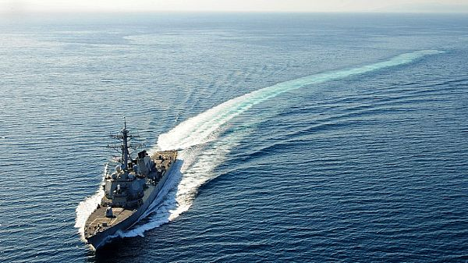

Slide 9
Guilty Stumbling Stones

Slide 10

Rebuke

Slide 11
3 So watch yourselves.
‘If your brother sins, rebuke him; and if he repents, forgive him. 4 If he sins against you seven times in a day and seven times come back to you and says “I repent,” forgive him.’
Why would a disciple who is unrepentant need another disciple to rebuke them for a sin?

Slide 12
3 So watch yourselves.
‘If your brother sins, rebuke him; and if he repents, forgive him. 4 If he sins against you seven times in a day and seven times come back to you and says “I repent,” forgive him.’
Do not ignore or Gossip
Not a call to be a busybody or the church law cop
Be Specific in how they have sinned
Be careful (Gal. 6:1)
Goal is to move them towards repentance not to destroy
Keep it tight by involving others only as necessary

Slide 13
James 4:17 If anyone, then, knows the good they ought to do and doesn’t do it, it is sin for them.
Luke 17:3 So watch yourselves (be Steppingstones).
Do not become an accomplice to others sin

Slide 14
Forgive
Rebuke

Slide 15
3 So watch yourselves.
‘If your brother sins, rebuke him; and if he repents, forgive him. 4 If he sins against you seven times in a day and seven times come back to you and says “I repent,” forgive him.’

Slide 16
3 So watch yourselves.
‘If your brother sins, rebuke him; and if he repents, forgive him. 4 If he sins against you seven times in a day and seven times come back to you and says “I repent,” forgive him.’
Sin Rebuke Repentance Forgive Restoration
Forgiveness is essential in the restorative process
Forgiveness cannot be withheld from the repentant

Slide 17
What are some reasons people may use to as excuses to withhold forgiveness from a repentant?
Matthew 6:15 But if you do not forgive others their sins, your Father will not forgive your sins.
Eph. 4:32 Be kind and compassionate to one another, forgiving each other, just as in Christ God forgave you.
2 Cor. 2:7 Now instead, you ought to forgive and comfort him, so that he will not be overwhelmed by excessive sorrow.

Slide 18
1. Responsibility for One Another’s Sin Vs 1-4
Although disciples inevitably sin, avoid the guilt of provoking others to sin or leaving others in sin by failing to rebuke them or mercifully extending forgiveness to the repentant.
Disciples are responsible for each other’s sin; we must not set up others to stumble and we must cooperate with God’s merciful restoration when others inevitably sin.

Slide 19


Slide 20
5 The apostles said to the Lord, ‘Increase our faith!’

Slide 21
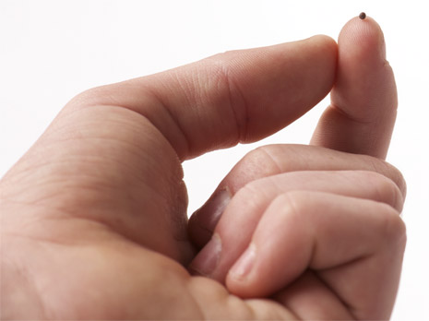
6 He replied, ‘If you have faith as small as a mustard seed, you can say to this mulberry tree, “Be uprooted and planted in the sea,” and it will obey you.
Faith is for doing extraordinary things . . .
Faith in God
Faith in his competencies
Faith in his character
Only a little faith is required to do the extraordinary . . .
being Jesus’ ordinary disciples

Slide 22
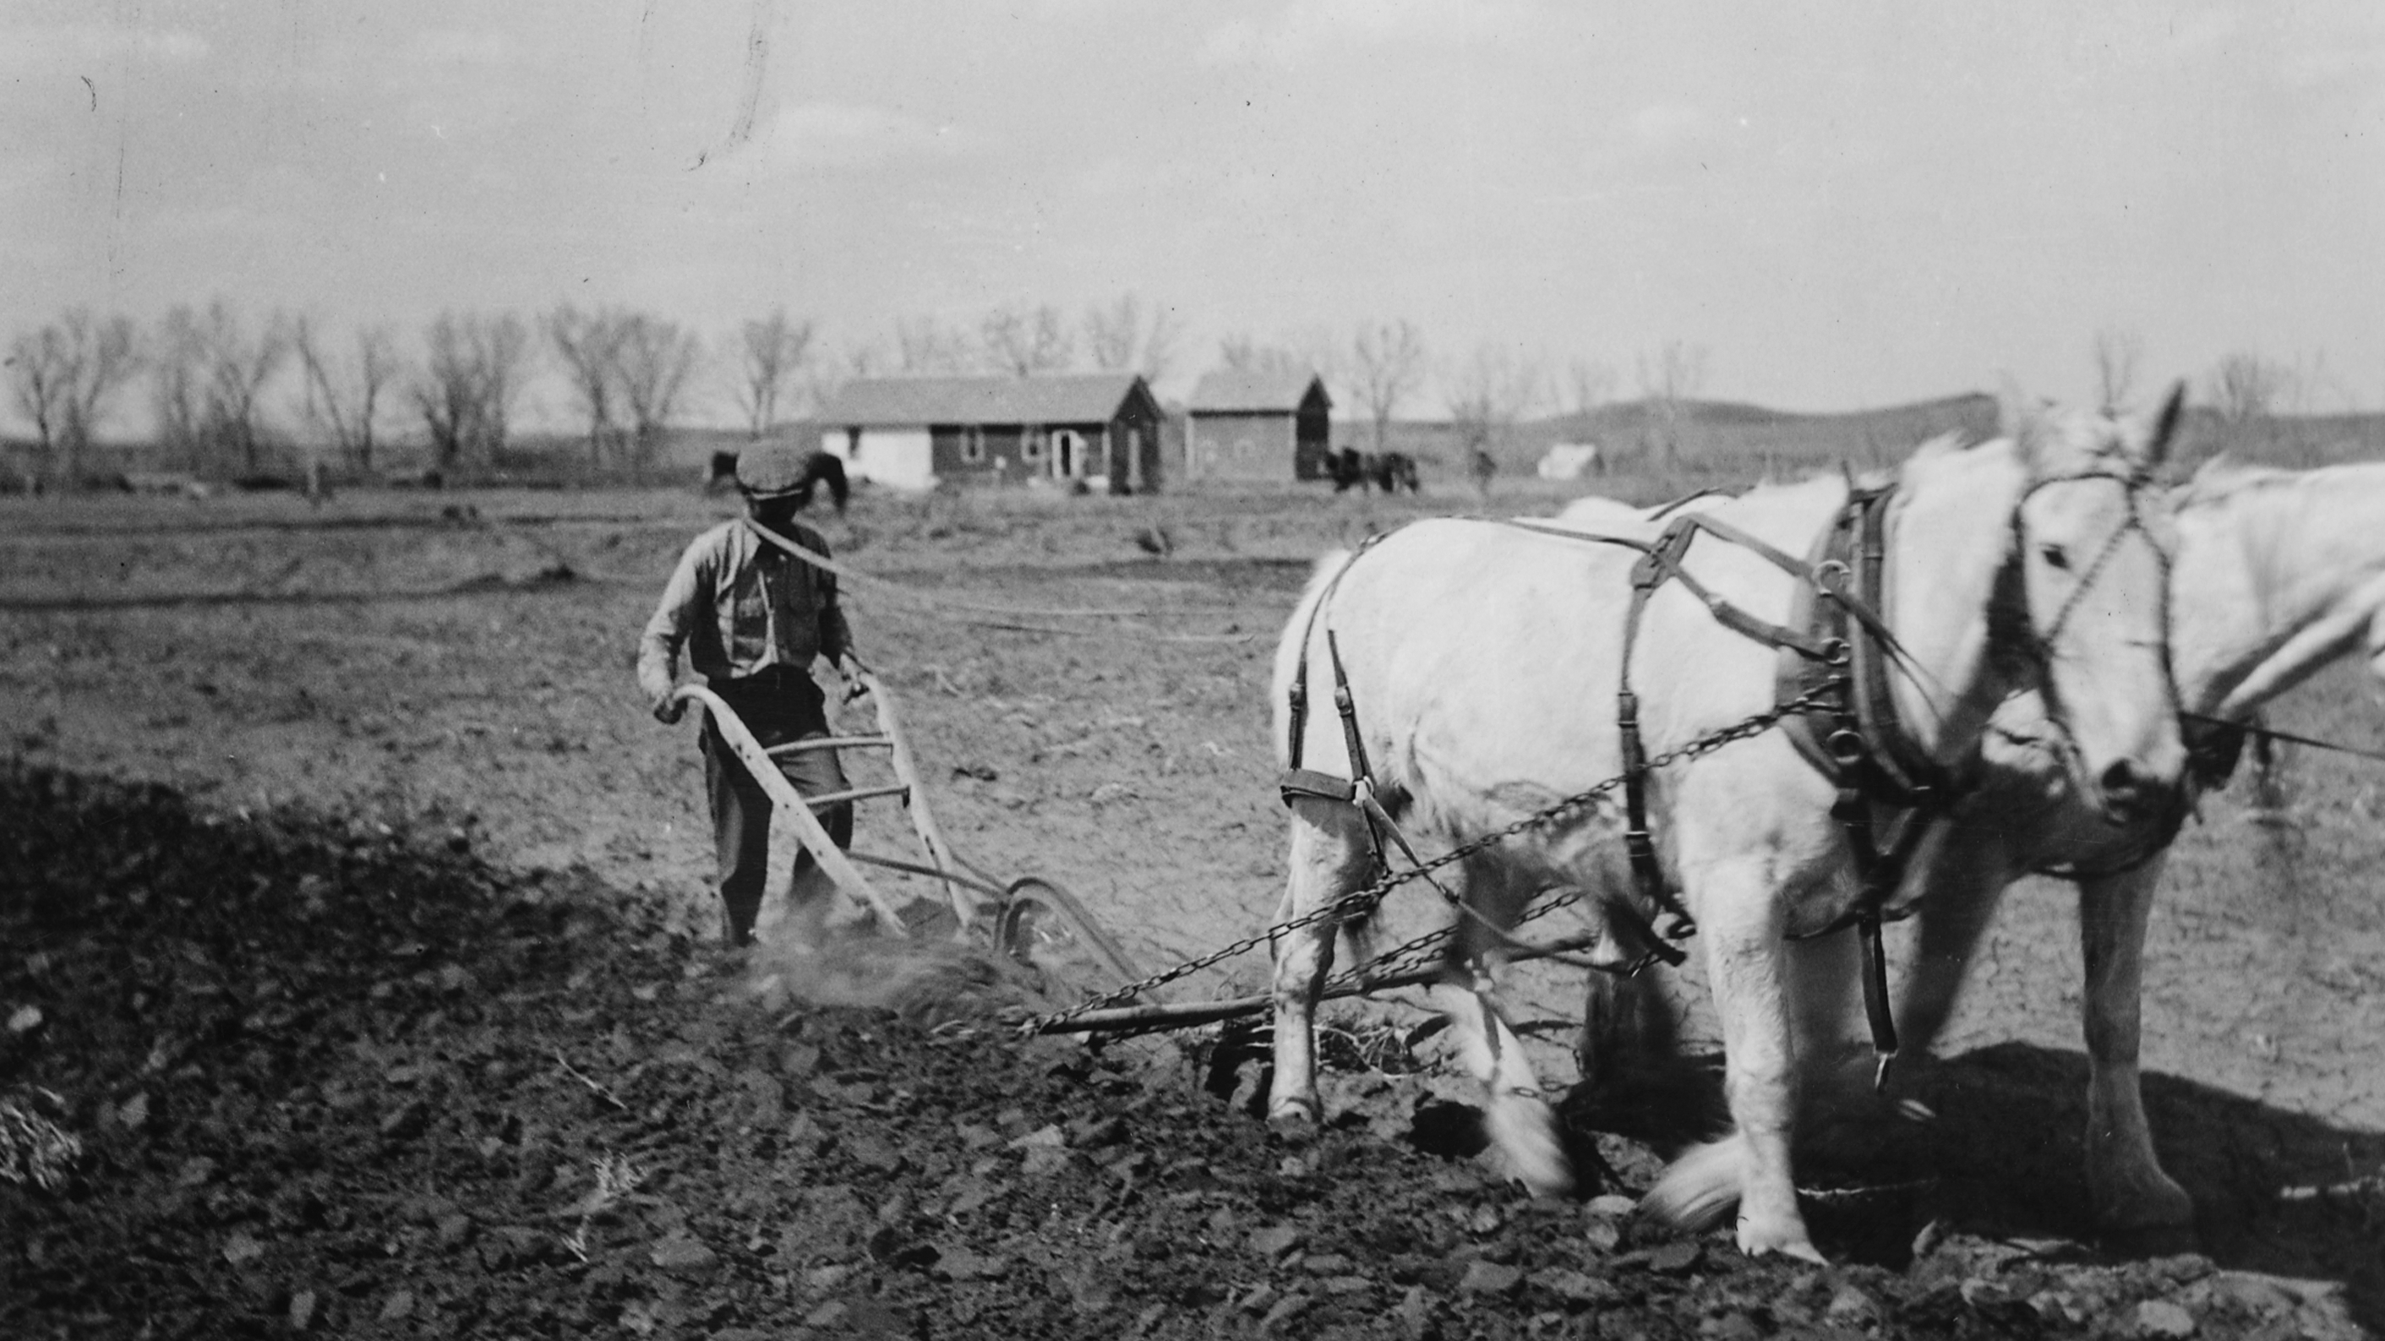
7 ‘Suppose one of you has a servant ploughing or looking after the sheep. Will he say to the servant when he comes in from the field, “Come along now and sit down to eat”? 8 Won’t he rather say, “Prepare my supper, get yourself ready and wait on me while I eat and drink; after that you may eat and drink”? 9 Would he thank the servant because he did what he was told to do? (No!)
Fulfillment of role as servant is just ordinary servanthood; it is what is expected by the master
The master is not indebted to the servant because he obeyed

Slide 23
10 So you also, when you have done everything you were told to do, should say, “We are unworthy servants; we have only done our duty.”’
Obeying Jesus’ Word to do extraordinary things is just ordinary discipleship

Slide 24
10 So you also, when you have done everything you were told to do, should say, “We are unworthy servants; we have only done our duty.”’
Obeying Jesus’ Word to do extraordinary things is just ordinary discipleship
Doing ordinary discipleship does not indebt Jesus to us
The Lord expects and is worthy of such extraordinary ordinary discipleship
We are responsible for exercising the faith we have

Slide 25
2. Responsibility to Exercise Faith Vs 5-10
Exercising a smidgen of faith in God’s character and competency results in Jesus’ disciples performing the extraordinary which includes obedient service, ordinary faithfulness that God expects and is worthy of.
Our faithfulness is an outflow of exercising our faith in God
Disciples who responsibly exercise the faith they already have find the extraordinary ability to faithfully obey the Lord Jesus’ commands in ordinary discipleship, something he expects and is worthy of.

Slide 26
If we have believed to receive Jesus, we already have and exercised faith in God’s Love and power to set us free from the penalty and power of sin
We can say no to sin and yes to God
We can take risks of faith to become faithful in extraordinary discipleship
We just need to exercise the faith that God has allotted to each of us

Slide 27
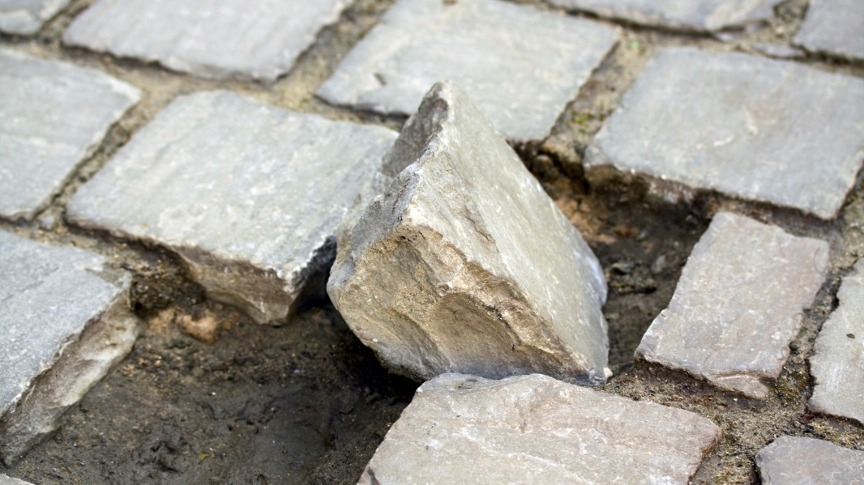

Faithfulness in extraordinary ordinary discipleship, something the Lord Jesus expects and deserves and includes taking responsibility for each other’s sin, requires responsible exercise of the faith we already have.
What is God presently asking you to do that you need to exercise faith to obey?
What divine competencies, or characteristics or promises do you need to trust in so you can obey?

