Slide 1
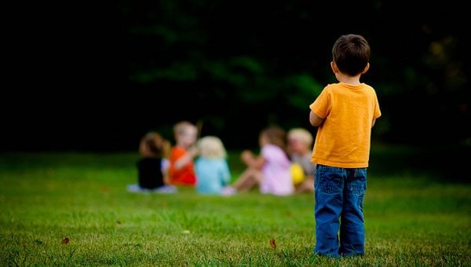

Slide 2
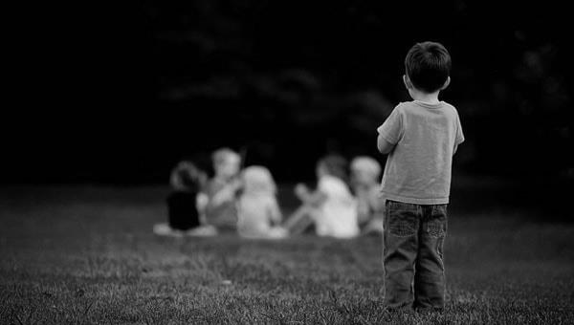
Luke 17
11 Now on his way to Jerusalem, Jesus travelled along the border between Samaria and Galilee. 12 As he was going into a village, ten men who had leprosy met him. They stood at a distance 13 and called out in a loud voice, ‘Jesus, Master, have pity on us!’
14 When he saw them, he said, ‘Go, show yourselves to the priests.’ And as they went, they were cleansed.’

Slide 3
15 One of them, when he saw he was healed, came back, praising God in a loud voice. 16 He threw himself at Jesus’ feet and thanked him – and he was a Samaritan.
17 Jesus asked, ‘Were not all ten cleansed? Where are the other nine? 18 Has no one returned to give praise to God except this foreigner?’ 19 Then he said to him, ‘Rise and go; your faith has made you well.’

Slide 4
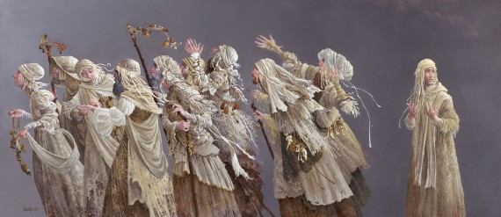

Slide 5
God’s People
God’s
Presence

Slide 6
God’s People
God’s
Presence
Lepers

Slide 7
15 One of them, when he saw he was healed, came back, praising God in a loud voice. 16 He threw himself at Jesus’ feet and thanked him – and he was a Samaritan.
17 Jesus asked, ‘Were not all ten cleansed? Where are the other nine? 18 Has no one returned to give praise to God except this foreigner?’ 19 Then he said to him, ‘Rise and go; your faith has made you well.’

Slide 8
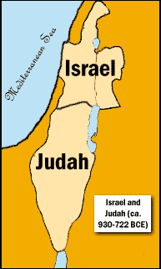
Origin of Samaritans
722 BCE

Slide 9
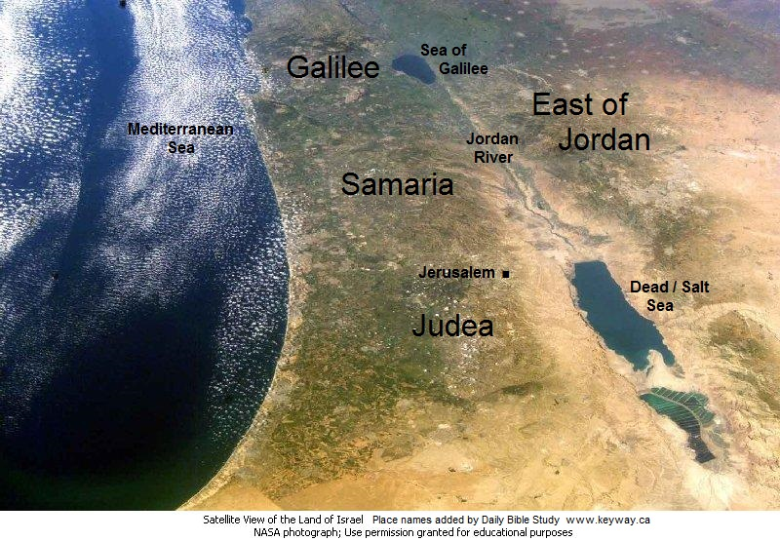
Mt. Gerizim

Slide 10
God’s People
Lepers
God’s
Presence
Samaritans

Slide 11
11 Now on his way to Jerusalem, Jesus travelled along the border between Samaria and Galilee. 12 As he was going into a village, ten men who had leprosy met him. They stood at a distance 13 and called out in a loud voice, ‘Jesus, Master, have pity on us!’
Appealed to Jesus as Master, subordinating themselves to his compassion in hope that through him God would cleanse and bring them inside.

Slide 12
1. Outside God’s Presence
Put outside God’s people and presence by his leprosy and ancestry, the Samaritan subordinated himself to Jesus’ compassion in hope that through him God would cleanse and bring him inside.

Slide 13
Eph. 2:1-3
As for you, you were dead in your transgressions and sins, 2 in which you used to live when you followed the ways of this world and of the ruler of the kingdom of the air, the spirit who is now at work in those who are disobedient. 3 All of us also lived among them at one time, gratifying the cravings of our sinful nature and following its desires and thoughts. Like the rest, we were by nature deserving of wrath.

Slide 14
Eph. 2:1-3
As for you, you were dead in your transgressions and sins, 2 in which you used to live when you followed the ways of this world and of the ruler of the kingdom of the air, the spirit who is now at work in those who are disobedient. 3 All of us also lived among them at one time, gratifying the cravings of our sinful nature and following its desires and thoughts. Like the rest, we were by nature deserving of wrath.

Slide 15
Eph. 2:1-3
As for you, you were dead in your transgressions and sins, 2 in which you used to live when you followed the ways of this world and of the ruler of the kingdom of the air, the spirit who is now at work in those who are disobedient. 3 All of us also lived among them at one time, gratifying the cravings of our sinful nature and following its desires and thoughts. Like the rest, we were by nature deserving of wrath.

Slide 16
Col. 1: 21 Once you were alienated from God and were enemies in your minds because of your evil behaviour. 22 But now he has reconciled you by Christ’s physical body through death to present you holy in his sight, without blemish and free from accusation –

Slide 17
God’s People
God’s
Presence
Us

Slide 18
1. Outside God’s Presence
Put outside God’s people and presence by his leprosy and ancestry, the Samaritan subordinated himself to Jesus’ compassion in hope that through him God would cleanse and bring him inside.
Put outside God’s people and presence by our human ancestry and sin, we can subordinate ourselves to Jesus’ compassion in hope that through him God would cleanse us and bring us inside.

Slide 19
Imagine what the Leper’s life would have been like if he had not put his hope in Jesus?
Imagine how your life would be if you had not put your hope in Jesus?

Slide 20
How do you know that your calling out in hope has actually resulted in your cleansing so you can come inside?

Slide 21
14 When he saw them, he said, ‘Go, show yourselves to the priests.’ And as they went, they were cleansed.
15 One of them, when he saw he was healed . . .
Samaritan saw he was cleansed while on the way to see the priest

Slide 22
14 When he saw them, he said, ‘Go, show yourselves to the priests.’ And as they went, they were cleansed.
15 One of them, when he saw he was healed came back, praising God in a loud voice. 16 He threw himself at Jesus’ feet and thanked him –he was a Samaritan.
17 Jesus asked, ‘Were not all ten cleansed? Where are the other nine? 18 Has no one returned to give praise to God except this foreigner?’ 19 Then he said to him, ‘Rise and go; your faith has made you well.’

Slide 23
14 When he saw them, he said, ‘Go, show yourselves to the priests.’ And as they went, they were cleansed.
15 One of them, when he saw he was healed came back, praising God in a loud voice. 16 He threw himself at Jesus’ feet and thanked him –he was a Samaritan.
17 Jesus asked, ‘Were not all ten cleansed? Where are the other nine? 18 Has no one returned to give praise to God except this foreigner?’ 19 Then he said to him, ‘Rise and go; your faith has made you well.’
By faith the Samaritan saw in Jesus the powerful and merciful presence of God and returned to worship him

Slide 24
2. Inside God’s Presence
Believing in and recognizing his healing, rather than going to the temple to show himself to a priest, the Samaritan gratefully returned to passionately worship Jesus, to worship God.

Slide 25
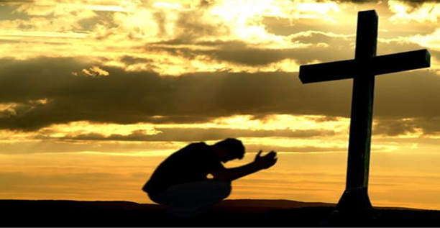
Like the Samaritan leper
Genuine hope that calls out to Jesus to save should result in tangible cleansing
Titus 2:11-14 For the grace of God has appeared that offers salvation to all people. 12 It teaches us to say ‘No’ to ungodliness and worldly passions, and to live self-controlled, upright and godly lives in this present age, 13 while we wait for the blessed hope – the appearing of the glory of our great God and Saviour, Jesus Christ, 14 who gave himself for us to redeem us from all wickedness and to purify for himself a people that are his very own, eager to do what is good.

Slide 26
Like the Samaritan leper
Genuine hope that calls out to Jesus to save should result in tangible cleansing
Titus 2:11-14 For the grace of God has appeared that offers salvation to all people. 12 It teaches us to say ‘No’ to ungodliness and worldly passions, and to live self-controlled, upright and godly lives in this present age, 13 while we wait for the blessed hope – the appearing of the glory of our great God and Saviour, Jesus Christ, 14 who gave himself for us to redeem us from all wickedness and to purify for himself a people that are his very own, eager to do what is good.

Slide 27
Like the Samaritan leper
Genuine hope that calls out to Jesus to save should result in tangible cleansing
That evidence should affirm to us that Jesus is our great God and Saviour
Col 1:26 the mystery that has been kept hidden for ages and generations, but is now disclosed to the Lord’s people. 27 To them God has chosen to make known among the Gentiles the glorious riches of this mystery, which is Christ in you, the hope of glory.

Slide 28
Like the Samaritan leper
Genuine hope that calls out to Jesus to save should result in tangible evidence of salvation
That evidence should affirm to us that Jesus is our great God and Saviour
How can we not passionately worship at Jesus’ feet?

Slide 29
Believing in and recognizing that Jesus’ passion has cleansed us of sin to bring us into God’s people and presence, we now gratefully and passionately worship Jesus, our great God and Saviour.

Slide 30
Conclusion
Like the Samaritan leper
We were all hopelessly outside . . .
We can call out ‘Jesus, Master, have pity on us.’
We can recognize God, Jesus has cleansed us.

Slide 31
How can we not passionately worship at Jesus’ feet?

