Slide 1

However, when the Son of Man comes, will he find faith on the earth?

Slide 2
In the now but not yet Kingdom, Jesus’ disciples can expect pushback from kingdom of this world
In fully realized Kingdom of God all evil is vanquished
TIMELINE

Slide 3
In the now but not yet Kingdom, Jesus’ disciples will be tempted to try and hold dual citizenship
In fully realized Kingdom of God all evil is vanquished
TIMELINE

Slide 4
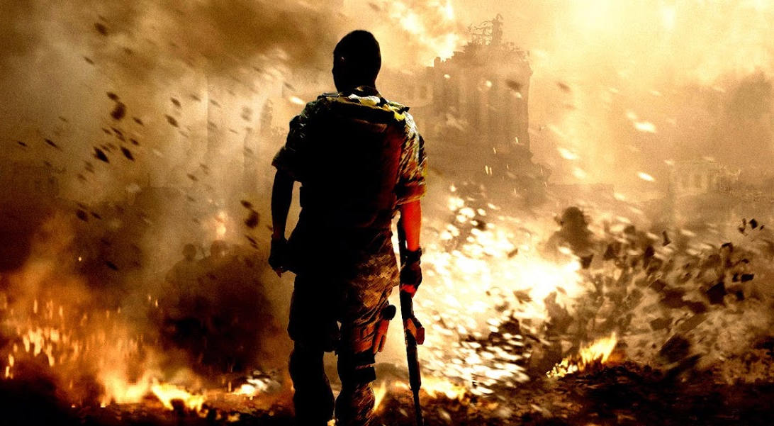
War Zone

Slide 5
You have to fight to stay faithful

Slide 6
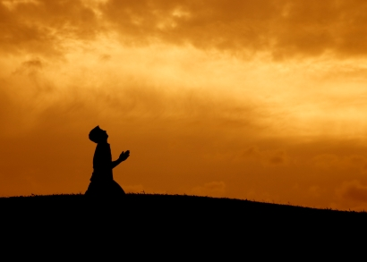
War Room

Slide 7

Satan’s rule
God’s rule

Slide 8
9 To some who were confident of their own righteousness and looked down on everyone else, Jesus told this parable: 10 ‘Two men went up to the temple to pray, one a Pharisee and the other a tax collector. 11 The Pharisee stood by himself and prayed: “God, I thank you that I am not like other people – robbers, evildoers, adulterers – or even like this tax collector. 12 I fast twice a week and give a tenth of all I get.”
13 ‘But the tax collector stood at a distance. He would not even look up to heaven, but beat his breast and said, “God, have mercy on me, a sinner.”
14 ‘I tell you that this man, rather than the other, went home justified before God. For all those who exalt themselves will be humbled, and those who humble themselves will be exalted.’

Slide 9
15 People were also bringing babies to Jesus for him to place his hands on them. When the disciples saw this, they rebuked them. 16 But Jesus called the children to him and said, ‘Let the little children come to me, and do not hinder them, for the kingdom of God belongs to such as these. 17 Truly I tell you, anyone who will not receive the kingdom of God like a little child will never enter it.’

Slide 10
18 A certain ruler asked him, ‘Good teacher, what must I do to inherit eternal life?’ 19 ‘Why do you call me good?’ Jesus answered. ‘No one is good – except God alone. 20 You know the commandments: “You shall not commit adultery, you shall not murder, you shall not steal, you shall not give false testimony, honour your father and mother.” 21 ‘All these I have kept since I was a boy,’ he said. 22 When Jesus heard this, he said to him, ‘You still lack one thing. Sell everything you have and give to the poor, and you will have treasure in heaven. Then come, follow me.’

Slide 11
23 When he heard this, he became very sad, because he was very wealthy. 24 Jesus looked at him and said, ‘How hard it is for the rich to enter the kingdom of God! 25 Indeed, it is easier for a camel to go through the eye of a needle than for someone who is rich to enter the kingdom of God.’
26 Those who heard this asked, ‘Who then can be saved?’
27 Jesus replied, ‘What is impossible with man is possible with God.’

Slide 12
28 Peter said to him, ‘We have left all we had to follow you!’
29 ‘Truly I tell you,’ Jesus said to them, ‘no one who has left home or wife or brothers or sisters or parents or children for the sake of the kingdom of God 30 will fail to receive many times as much in this age, and in the age to come eternal life.’
Justified or declared righteous, receive Kingdom of God, saved, eternal life ties everything together under the theme of becoming Kingdom of God citizens.

Slide 13
Satan’s rule
God’s rule

Slide 14
9 To some who were confident of their own righteousness and looked down on everyone else, Jesus told this parable: 10 ‘Two men went up to the temple to pray, one a Pharisee and the other a tax collector. 11 The Pharisee stood by himself and prayed: “God, I thank you that I am not like other people – robbers, evildoers, adulterers – or even like this tax collector. 12 I fast twice a week and give a tenth of all I get.”
13 ‘But the tax collector stood at a distance. He would not even look up to heaven, but beat his breast and said, “God, have mercy on me, a sinner.”
Separates himself from others which is standard of Pharisaism

Slide 15
9 To some who were confident of their own righteousness and looked down on everyone else, Jesus told this parable: 10 ‘Two men went up to the temple to pray, one a Pharisee and the other a tax collector. 11 The Pharisee stood by himself and prayed: “God, I thank you that I am not like other people – robbers, evildoers, adulterers – or even like this tax collector. 12 I fast twice a week and give a tenth of all I get.”
13 ‘But the tax collector stood at a distance. He would not even look up to heaven, but beat his breast and said, “God, have mercy on me, a sinner.”
Arrogantly judges others in self-aggrandizing praise

Slide 16
9 To some who were confident of their own righteousness and looked down on everyone else, Jesus told this parable: 10 ‘Two men went up to the temple to pray, one a Pharisee and the other a tax collector. 11 The Pharisee stood by himself and prayed: “God, I thank you that I am not like other people – robbers, evildoers, adulterers – or even like this tax collector. 12 I fast twice a week and give a tenth of all I get.”
13 ‘But the tax collector stood at a distance. He would not even look up to heaven, but beat his breast and said, “God, have mercy on me, a sinner.”
Self-righteous; thinks his law-keeping indebts God to declare him righteous

Slide 17
14 ‘I tell you that this man, rather than the other, went home justified before God. For all those who exalt themselves will be humbled, and those who humble themselves will be exalted.’
He asks for nothing and receives deserved condemnation

Slide 18
9 To some who were confident of their own righteousness and looked down on everyone else, Jesus told this parable: 10 ‘Two men went up to the temple to pray, one a Pharisee and the other a tax collector. 11 The Pharisee stood by himself and prayed: “God, I thank you that I am not like other people – robbers, evildoers, adulterers – or even like this tax collector. 12 I fast twice a week and give a tenth of all I get.”
13 ‘But the tax collector stood at a distance. He would not even look up to heaven, but beat his breast and said, “God, have mercy on me, a sinner.”
Humble position and body posture, unworthy sinner

Slide 19
9 To some who were confident of their own righteousness and looked down on everyone else, Jesus told this parable: 10 ‘Two men went up to the temple to pray, one a Pharisee and the other a tax collector. 11 The Pharisee stood by himself and prayed: “God, I thank you that I am not like other people – robbers, evildoers, adulterers – or even like this tax collector. 12 I fast twice a week and give a tenth of all I get.”
13 ‘But the tax collector stood at a distance. He would not even look up to heaven, but beat his breast and said, “God, have mercy on me, a sinner.”
Sorrow over his sin

Slide 20
9 To some who were confident of their own righteousness and looked down on everyone else, Jesus told this parable: 10 ‘Two men went up to the temple to pray, one a Pharisee and the other a tax collector. 11 The Pharisee stood by himself and prayed: “God, I thank you that I am not like other people – robbers, evildoers, adulterers – or even like this tax collector. 12 I fast twice a week and give a tenth of all I get.”
13 ‘But the tax collector stood at a distance. He would not even look up to heaven, but beat his breast and said, “God, have mercy on me, a sinner.”
Supplication for forgiveness based on God’s mercy

Slide 21
14 ‘I tell you that this man, rather than the other, went home justified before God. For all those who exalt themselves will be humbled, and those who humble themselves will be exalted.’
He gets what he asks for, God’s mercy and leaves justified

Slide 22
The self-righteous and judgmental Pharisee left condemned after his arrogant self-congratulatory praise, while the humble tax collector left justified by God after his sorrowful supplication for God’s mercy.

Slide 23
Receiving the Kingdom of God
1. Sorrow Vs 9-14
Until people humbly acknowledge their sinfulness before God and sorrowfully appeal to God’s mercy, they remain in the kingdom of darkness under sin’s penalty and power.

Slide 24

SORROW

Slide 25
SIMPLICITY
SORROW

Slide 26
15 People were also bringing babies to Jesus for him to place his hands on them. When the disciples saw this, they rebuked them. 16 But Jesus called the children to him and said, ‘Let the little children come to me, and do not hinder them, for the kingdom of God belongs to such as these. 17 Truly I tell you, anyone who will not receive the kingdom of God like a little child will never enter it.’
Childlike trust and openness to God’s grace

Slide 27
Receiving the Kingdom of God
1. Sorrow Vs 9-14
2. Simplicity Vs 15-17
Through uncomplicated simple childlike trust and openness to God’s gracious salvation in Christ, people leave the kingdom of darkness to receive citizenship in the Kingdom of God.

Slide 28
SURRENDER
SIMPLICITY
SORROW

Slide 29
18 A certain ruler asked him, ‘Good teacher, what must I do to inherit eternal life?’ 19 ‘Why do you call me good?’ Jesus answered. ‘No one is good – except God alone. 20 You know the commandments: “You shall not commit adultery, you shall not murder, you shall not steal, you shall not give false testimony, honour your father and mother.” 21 ‘All these I have kept since I was a boy,’ he said. 22 When Jesus heard this, he said to him, ‘You still lack one thing. Sell everything you have and give to the poor, and you will have treasure in heaven. Then come, follow me.’
Pharisees don’t get Kingdom citizenship while tax collectors and children do, so what about me?

Slide 30
18 A certain ruler asked him, ‘Good teacher, what must I do to inherit eternal life?’ 19 ‘Why do you call me good?’ Jesus answered. ‘No one is good – except God alone. 20 You know the commandments: “You shall not commit adultery, you shall not murder, you shall not steal, you shall not give false testimony, honour your father and mother.” 21 ‘All these I have kept since I was a boy,’ he said. 22 When Jesus heard this, he said to him, ‘You still lack one thing. Sell everything you have and give to the poor, and you will have treasure in heaven. Then come, follow me.’
Calling Jesus ‘good’ in attempt to ingratiate Jesus
Is there something more I have to do to merit eternal life

Slide 31
18 A certain ruler asked him, ‘Good teacher, what must I do to inherit eternal life?’ 19 ‘Why do you call me good?’ Jesus answered. ‘No one is good – except God alone. 20 You know the commandments: “You shall not commit adultery, you shall not murder, you shall not steal, you shall not give false testimony, honour your father and mother.” 21 ‘All these I have kept since I was a boy,’ he said. 22 When Jesus heard this, he said to him, ‘You still lack one thing. Sell everything you have and give to the poor, and you will have treasure in heaven. Then come, follow me.’
Higher goodness of God must be achieved for eternal life as in perfect keeping of the commandments

Slide 32
18 A certain ruler asked him, ‘Good teacher, what must I do to inherit eternal life?’ 19 ‘Why do you call me good?’ Jesus answered. ‘No one is good – except God alone. 20 You know the commandments: “You shall not commit adultery, you shall not murder, you shall not steal, you shall not give false testimony, honour your father and mother.” 21 ‘All these I have kept since I was a boy,’ he said. 22 When Jesus heard this, he said to him, ‘You still lack one thing. Sell everything you have and give to the poor, and you will have treasure in heaven. Then come, follow me.’
Summarizes 10 commandments by skipping first 4 which address relationship with God to 5 of the 6 commandments governing human relationships (omits 6th: you shall not covet)

Slide 33
18 A certain ruler asked him, ‘Good teacher, what must I do to inherit eternal life?’ 19 ‘Why do you call me good?’ Jesus answered. ‘No one is good – except God alone. 20 You know the commandments: “You shall not commit adultery, you shall not murder, you shall not steal, you shall not give false testimony, honour your father and mother.” 21 ‘All these I have kept since I was a boy,’ he said. 22 When Jesus heard this, he said to him, ‘You still lack one thing. Sell everything you have and give to the poor, and you will have treasure in heaven. Then come, follow me.’
application of final command to rich ruler
break 6th command breaks the 1st: no other gods before me

Slide 34
18 A certain ruler asked him, ‘Good teacher, what must I do to inherit eternal life?’ 19 ‘Why do you call me good?’ Jesus answered. ‘No one is good – except God alone. 20 You know the commandments: “You shall not commit adultery, you shall not murder, you shall not steal, you shall not give false testimony, honour your father and mother.” 21 ‘All these I have kept since I was a boy,’ he said. 22 When Jesus heard this, he said to him, ‘You still lack one thing. Sell everything you have and give to the poor, and you will have treasure in heaven. Then come, follow me.’
turning from serving money to using money to serve God’s saving purposes

Slide 35
In order to receive eternal life, the rich ruler had to surrender his idol ‘wealth’ to make Jesus his primary allegiance and use that wealth for God’s saving purposes.

Slide 36
Receiving the Kingdom of God
1. Sorrow Vs 9-14
2. Simplicity Vs 15-17
3. Surrender Vs 18-22
Reception of eternal life/entrance into God’s Kingdom requires total surrender of all we are and have to follow the Lord and serve his purpose of growing his Kingdom.

Slide 37



SATISFACTION
SURRENDER
SIMPLICITY
SORROW

Slide 38
Receiving the Kingdom of God
1. Sorrow Vs 9-14
2. Simplicity Vs 15-17
3. Surrender Vs 18-22
4. Satisfaction Vs 23-30

Slide 39
23 When he heard this, he became very sad, because he was very wealthy. 24 Jesus looked at him and said, ‘How hard it is for the rich to enter the kingdom of God! 25 Indeed, it is easier for a camel to go through the eye of a needle than for someone who is rich to enter the kingdom of God.’
26 Those who heard this asked, ‘Who then can be saved?’
27 Jesus replied, ‘What is impossible with man is possible with God.’
28 Peter said to him, ‘We have left all we had to follow you!’
29 ‘Truly I tell you,’ Jesus said to them, ‘no one who has left home or wife or brothers or sisters or parents or children for the sake of the kingdom of God 30 will fail to receive many times as much in this age, and in the age to come eternal life.’

Slide 40
Receiving the Kingdom of God
1. Sorrow Vs 9-14
2. Simplicity Vs 15-17
3. Surrender Vs 18-22
4. Satisfaction Vs 23-30
Those who surrender all to Jesus have no regrets; they find satisfaction as present day Kingdom citizens followed by full satiation when the Kingdom of God is fully realized.
Requires a risk of faith that life with Jesus is better

Slide 41
Who then can be saved?
SATISFACTION
SURRENDER
SIMPLICITY
SORROW

Slide 42
23 When he heard this, he became very sad, because he was very wealthy. 24 Jesus looked at him and said, ‘How hard it is for the rich to enter the kingdom of God! 25 Indeed, it is easier for a camel to go through the eye of a needle than for someone who is rich to enter the kingdom of God.’
26 Those who heard this asked, ‘Who then can be saved?’
It was impossible for the rich ruler to switch his primary allegiance to his money to the Lord and surrender control of that money to the Lord’s saving purposes.

Slide 43
23 When he heard this, he became very sad, because he was very wealthy. 24 Jesus looked at him and said, ‘How hard it is for the rich to enter the kingdom of God! 25 Indeed, it is easier for a camel to go through the eye of a needle than for someone who is rich to enter the kingdom of God.’
26 Those who heard this asked, ‘Who then can be saved?’

Slide 44
Who then can be saved?
SATISFACTION
SURRENDER
SIMPLICITY
SORROW

Slide 45
2 Cor. 4:4
And even if our gospel is veiled, it is veiled to those who are perishing. 4 The god of this age has blinded the minds of unbelievers, so that they cannot see the light of the gospel that displays the glory of Christ, who is the image of God.
Blinded that they are slaves to sin
Hardens hearts so no longer have childlike trust
Inescapable grip of idolatry
Lies keep us from believing that only Jesus can satisfy

Slide 46
23 When he heard this, he became very sad, because he was very wealthy. 24 Jesus looked at him and said, ‘How hard it is for the rich to enter the kingdom of God! 25 Indeed, it is easier for a camel to go through the eye of a needle than for someone who is rich to enter the kingdom of God.’
26 Those who heard this asked, ‘Who then can be saved?’ 27 Jesus replied, ‘What is impossible with man is possible with God.’

Slide 47
SUPERNATURAL
SATISFACTION
SURRENDER
SIMPLICITY
SORROW

Slide 48
Receiving the Kingdom of God
1. Sorrow Vs 9-14
2. Simplicity Vs 15-17
3. Surrender Vs 18-22
4. Satisfaction Vs 23-30
5. Supernatural Vs 23-30
Sorrowful appeals to God’s mercy with simple trust in and total surrender to the Saviour and his saving purposes is impossible without God’s supernatural intervention.

Slide 49
John 16:8-11 When he (Holy Spirit) comes, he will prove the world to be in the wrong about sin and righteousness and judgment:
9 about sin, because people do not believe in me; 10 about righteousness, because I am going to the Father, where you can see me no longer; 11 and about judgment, because the prince of this world now stands condemned.

Slide 50
SUPERNATURAL
Satan’s rule
God’s rule

Slide 51
SUPERNATURAL
SATISFACTION
SURRENDER
SIMPLICITY
Eph. 6:12 For our struggle is not against flesh and blood, but against the rulers, against the authorities, against the powers of this dark world and against the spiritual forces of evil in the heavenly realms.
SORROW

Slide 52
SUPERNATURAL
SATISFACTION
SURRENDER
SIMPLICITY
Luke 8:11-12 (Parable of the Soils) The evil one snatches the Gospel truth away from unbelievers’ hearts before it has time to even germinate, let alone take root.
SORROW

Slide 53
You are a Miracle!
SATISFACTION
SURRENDER
SIMPLICITY
SORROW

Slide 54
SUPERNATURAL
SATISFACTION
SURRENDER
SIMPLICITY
Luke 18:1 Then Jesus told his disciples . . . that they should always pray and not give up.
SORROW

Slide 55
SATISFACTION
SURRENDER
SIMPLICITY
SORROW
War Room

Slide 56
‘Satan trembles when he sees the weakest believer on his knees.’
William Cowper

Slide 57
Pray
1. That God revive his compelling love for the lost in us (2 Cor. 5:14)
2. For others’ fresh opportunities to hear the Gospel (Rom. 10:14-15)
3. That blinded minds open to the truth of the Gospel (2 Cor. 4:3-4)
4. For freedom from the dominion of darkness (Col. 1:13)
5. That the Holy Spirit would convict them of sin (John 16:8)
6. For God’s kindness to lead them to repentance (Rom. 2:4)
7. That they would be open to the message of the Gospel (Acts 16:14)
8. For their escape from the enemy’s snares (2 Tim. 2:26)
9. That eyes be opened to turn from the darkness to light (Acts 26:18)

