Slide 1

I

Slide 2
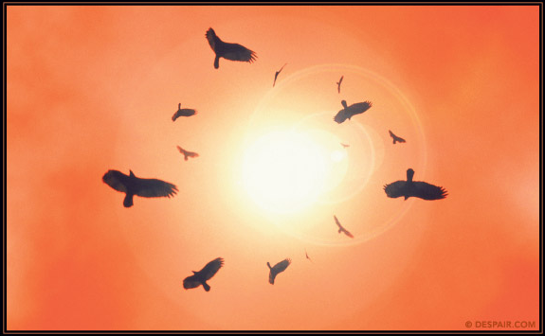

Slide 3
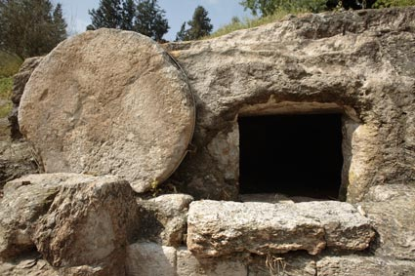
Luke 24
On the first day of the week, very early in the morning, the women took the spices they had prepared and went to the tomb. 2 They found the stone rolled away from the tomb, 3 but when they entered, they did not find the body of the Lord Jesus. 4 While they were wondering about this, suddenly two men in clothes that gleamed like lightning stood beside them. 5 In their fright the women bowed down with their faces to the ground, but the men said to them, ‘Why do you look for the living among the dead? 6 He is not here; he has risen! Remember how he told you, while he was still with you in Galilee: 7 “The Son of Man must be delivered over to the hands of sinners, be crucified and on the third day be raised again.”’ 8 Then they remembered his words.
Luke 18:31-34
‘We are going up to Jerusalem, and everything that is written by the prophets about the Son of Man will be fulfilled. He will be handed over to the Gentiles. They will mock him, insult him and spit on him; they will flog him and kill him. On the third day he will rise again.’

Slide 4

Luke 24
On the first day of the week, very early in the morning, the women took the spices they had prepared and went to the tomb. 2 They found the stone rolled away from the tomb, 3 but when they entered, they did not find the body of the Lord Jesus. 4 While they were wondering about this, suddenly two men in clothes that gleamed like lightning stood beside them. 5 In their fright the women bowed down with their faces to the ground, but the men said to them, ‘Why do you look for the living among the dead? 6 He is not here; he has risen! Remember how he told you, while he was still with you in Galilee: 7 “The Son of Man must be delivered over to the hands of sinners, be crucified and on the third day be raised again.”’ 8 Then they remembered his words.
Luke 18:31-34
‘We are going up to Jerusalem, and everything that is written by the prophets about the Son of Man will be fulfilled. He will be handed over to the Gentiles. They will mock him, insult him and spit on him; they will flog him and kill him. On the third day he will rise again.’

Slide 5

Luke 24
On the first day of the week, very early in the morning, the women took the spices they had prepared and went to the tomb. 2 They found the stone rolled away from the tomb, 3 but when they entered, they did not find the body of the Lord Jesus. 4 While they were wondering about this, suddenly two men in clothes that gleamed like lightning stood beside them. 5 In their fright the women bowed down with their faces to the ground, but the men said to them, ‘Why do you look for the living among the dead? 6 He is not here; he has risen! Remember how he told you, while he was still with you in Galilee: 7 “The Son of Man must be delivered over to the hands of sinners, be crucified and on the third day be raised again.”’ 8 Then they remembered his words.
Luke 18:31-34
‘We are going up to Jerusalem, and everything that is written by the prophets about the Son of Man will be fulfilled. He will be handed over to the Gentiles. They will mock him, insult him and spit on him; they will flog him and kill him. On the third day he will rise again.’

Slide 6
9 When they came back from the tomb, they told all these things to the Eleven and to all the others. 10 It was Mary Magdalene, Joanna, Mary the mother of James, and the others with them who told this to the apostles. 11 But they did not believe the women, because their words seemed to them like nonsense.
12 Peter, however, got up and ran to the tomb. Bending over, he saw the strips of linen lying by themselves, and he went away, wondering to himself what had happened.

Slide 7
9 When they came back from the tomb, they told all these things to the Eleven and to all the others. 10 It was Mary Magdalene, Joanna, Mary the mother of James, and the others with them who told this to the apostles. 11 But they did not believe the women, because their words seemed to them like nonsense.
12 Peter, however, got up and ran to the tomb. Bending over, he saw the strips of linen lying by themselves, and he went away, wondering to himself what had happened.

Slide 8
Now that same day two of them were going to a village called Emmaus, about seven miles from Jerusalem. 14 They were talking with each other about everything that had happened. 15 As they talked and discussed these things with each other, Jesus himself came up and walked along with them; 16 but they were kept from recognising him.
17 He asked them, ‘What are you discussing together as you walk along?’
They stood still, their faces downcast. 18 One of them, named Cleopas, asked him, ‘Are you the only one visiting Jerusalem who does not know the things that have happened there in these days?’

Slide 9
Now that same day two of them were going to a village called Emmaus, about seven miles from Jerusalem. 14 They were talking with each other about everything that had happened. 15 As they talked and discussed these things with each other, Jesus himself came up and walked along with them; 16 but they were kept from recognising him.
17 He asked them, ‘What are you discussing together as you walk along?’
They stood still, their faces downcast. 18 One of them, named Cleopas, asked him, ‘Are you the only one visiting Jerusalem who does not know the things that have happened there in these days?’

Slide 10
Now that same day two of them were going to a village called Emmaus, about seven miles from Jerusalem. 14 They were talking with each other about everything that had happened. 15 As they talked and discussed these things with each other, Jesus himself came up and walked along with them; 16 but they were kept from recognising him.
17 He asked them, ‘What are you discussing together as you walk along?’
They stood still, their faces downcast. 18 One of them, named Cleopas, asked him, ‘Are you the only one visiting Jerusalem who does not know the things that have happened there in these days?’

Slide 11
19 ‘What things?’ he asked.
‘About Jesus of Nazareth,’ they replied. ‘He was a prophet, powerful in word and deed before God and all the people. 20 The chief priests and our rulers handed him over to be sentenced to death, and they crucified him; 21 but we had hoped that he was the one who was going to redeem Israel. And what is more, it is the third day since all this took place. 22 In addition, some of our women amazed us. They went to the tomb early this morning
23 but didn’t find his body. They came and told us that they had seen a vision of angels, who said he was alive. 24 Then some of our companions went to the tomb and found it just as the women had said, but they did not see Jesus.’

Slide 12
19 ‘What things?’ he asked.
‘About Jesus of Nazareth,’ they replied. ‘He was a prophet, powerful in word and deed before God and all the people. 20 The chief priests and our rulers handed him over to be sentenced to death, and they crucified him; 21 but we had hoped that he was the one who was going to redeem Israel. And what is more, it is the third day since all this took place. 22 In addition, some of our women amazed us. They went to the tomb early this morning
23 but didn’t find his body. They came and told us that they had seen a vision of angels, who said he was alive. 24 Then some of our companions went to the tomb and found it just as the women had said, but they did not see Jesus.’

Slide 13
19 ‘What things?’ he asked.
‘About Jesus of Nazareth,’ they replied. ‘He was a prophet, powerful in word and deed before God and all the people. 20 The chief priests and our rulers handed him over to be sentenced to death, and they crucified him; 21 but we had hoped that he was the one who was going to redeem Israel. And what is more, it is the third day since all this took place. 22 In addition, some of our women amazed us. They went to the tomb early this morning
23 but didn’t find his body. They came and told us that they had seen a vision of angels, who said he was alive. 24 Then some of our companions went to the tomb and found it just as the women had said, but they did not see Jesus.’

Slide 15


Slide 16
1. Dead Hope VS 13-24
Two men gloomily drifted away from discipleship because their wishful Messianic hope that had died with Jesus’ crucifixion blinded them to Jesus’ reported and fulfilled prophesied resurrection.
People still drift away from following Jesus when their wishful hope in Jesus dies and then blinds them against hope in the real Jesus, the resurrected Messiah.

Slide 17
Wish Hopes become dead hopes

Slide 18
What are some wishful or false hopes that people put in Jesus that will eventually disappoint and let them down?

Slide 19
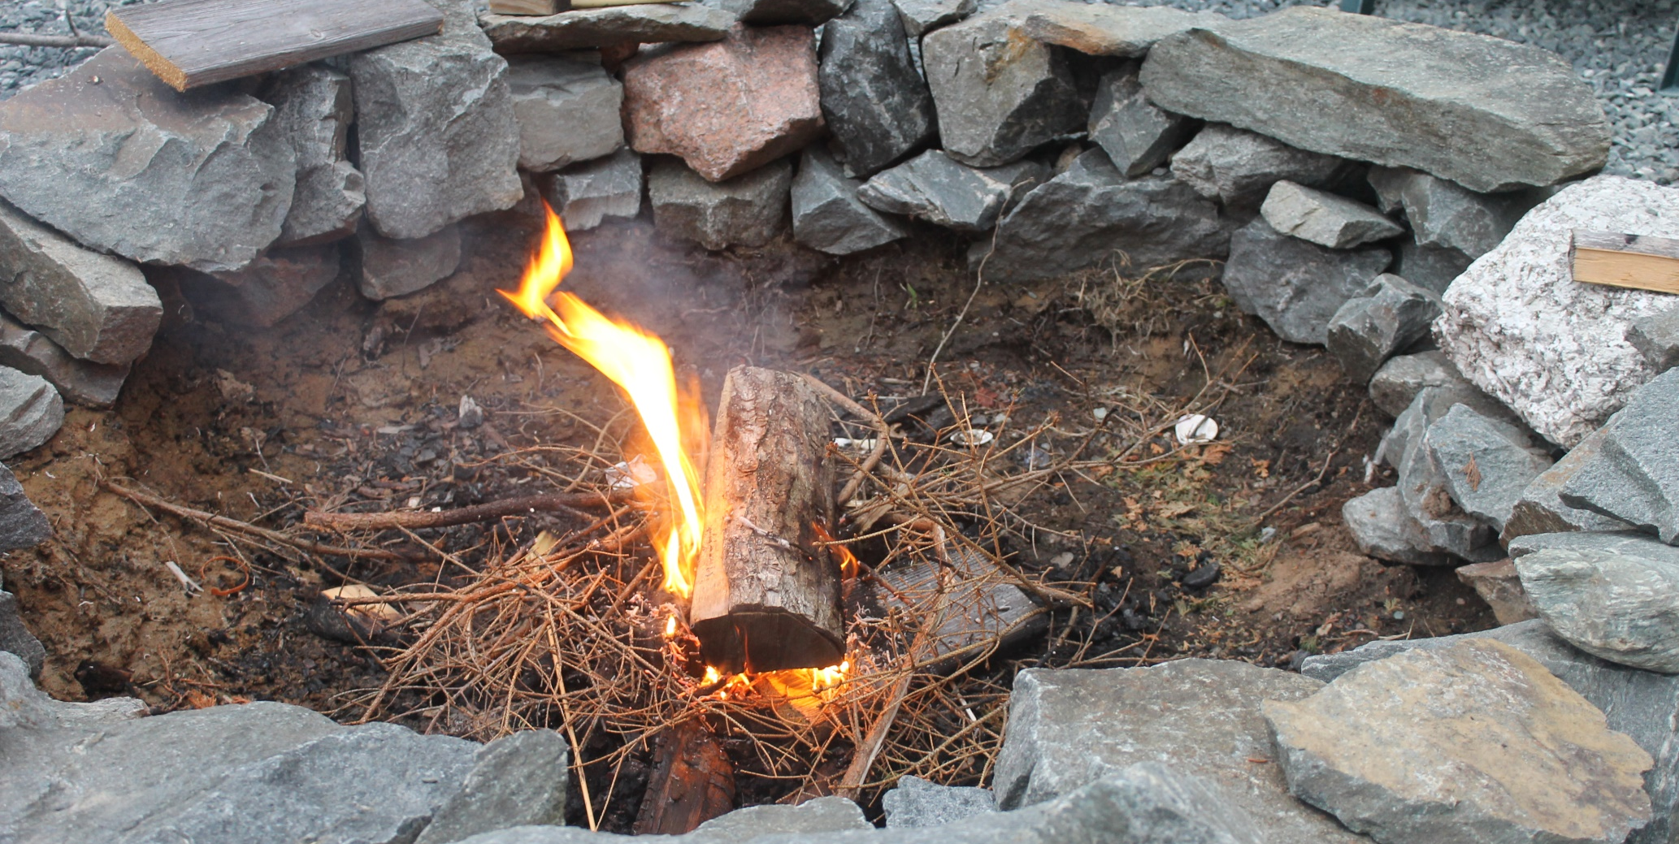
What do we do?

Slide 20
25 He said to them, ‘How foolish you are, and how slow to believe all that the prophets have spoken! 26 Did not the Messiah have to suffer these things and then enter his glory?’ 27 And beginning with Moses and all the Prophets, he explained to them what was said in all the Scriptures concerning himself.
The resurrected Lord pursued Cleopas and fellow disciple

Slide 21
25 He said to them, ‘How foolish you are, and how slow to believe all that the prophets have spoken! 26 Did not the Messiah have to suffer these things and then enter his glory?’ 27 And beginning with Moses and all the Prophets, he explained to them what was said in all the Scriptures concerning himself.

Slide 22
25 He said to them, ‘How foolish you are, and how slow to believe all that the prophets have spoken! 26 Did not the Messiah have to suffer these things and then enter his glory?’ 27 And beginning with Moses and all the Prophets, he explained to them what was said in all the Scriptures concerning himself.
Jesus shares his right interpretations of Scriptures
A little over 2 hour walk to share pertinent Scriptures explained in light of the suffering he had endured and the glory of his resurrection
Goal was to revive hope in him

Slide 23
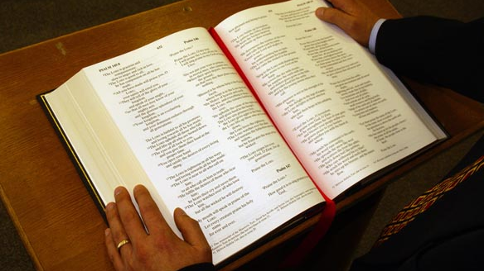

Slide 24
What are some Scriptures that Jesus may have used to rekindle a true hope in him as the Redeemer of Israel who had to first suffer before entering his glory?
Gen. 3:15
Exodus 12
Leviticus
Suffering pattern set by prophets
Isaiah 53
Psalm 22
Psalm 16

Slide 25
2. Revived Hope VS 25-27
Jesus pursued his foolishly drifting disciples to rightly interpret Scriptures for them, to remedy their slowness to understand his crucifixion and resurrection’s necessity, to revive their hope in him.
Don’t foolishly drift away because of a dead wish hope
Don’t let others drift away because of dead wish hopes

Slide 26
2. Revived Hope VS 25-27
Jesus pursued his foolishly drifting disciples to rightly interpret Scriptures for them, to remedy their slowness to understand his crucifixion and resurrection’s necessity, to revive their hope in him.
Christ’s love compels us to pursue those foolishly drifting away from discipleship, to revive their hope in the true Jesus, by sharing rightly interpreted Scripture concerning Jesus with them.
Pursue them and ask them why they are drifting away?
Share Scriptural truths to rekindle hope in resurrected Jesus

Slide 27


Slide 28
28 As they approached the village to which they were going, Jesus continued on as if he were going further. 29 But they urged him strongly, ‘Stay with us, for it is nearly evening; the day is almost over.’ So he went in to stay with them.
30 When he was at the table with them, he took bread, gave thanks, broke it and began to give it to them. 31 Then their eyes were opened and they recognised him, and he disappeared from their sight. 32 They asked each other, ‘Were not our hearts burning within us while he talked with us on the road and opened the Scriptures to us?’

Slide 29
33 They got up and returned at once to Jerusalem. There they found the Eleven and those with them, assembled together
34 and saying, ‘It is true! The Lord has risen and has appeared to Simon.’ 35 Then the two told what had happened on the way, and how Jesus was recognised by them when he broke the bread.
Burning, the hope rekindled by the Scriptures in Jesus being alive
Revelation in Jesus usual role as host to disciples in breaking of bread
Return to following Jesus and testifying about him

Slide 30
3. Wholehearted Hope VS 28-35
Scripturally kindled hope enabled drifting disciples to recognize Jesus as he broke the bread and having seen him, immediately returned to discipleship, testifying alongside Peter that their Lord had risen.
When Scriptural wholehearted hope in the crucified and resurrected Lord Jesus is kindled, people become disciples who never drift away, disciples who testify about their risen Lord to others.
Essential truth of Christ’s suffering death and resurrection

Slide 31
Conclusion
Certain hope in the crucified and resurrected Lord Jesus who fulfilled,
is fulfilling, and will fulfill God’s Scriptural saving purposes for us will keep us following him all our days.

