Slide 1
SEARCH: Clueless Person

Slide 2
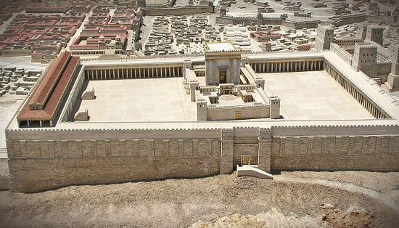
House of Prayer

Slide 3
Den of Robbers

Slide 4
Luke 19:41 As he approached Jerusalem and saw the city, he wept over it 42 and said, ‘If you, even you, had only known on this day what would bring you peace – but now it is hidden from your eyes. 43 The days will come upon you when your enemies will build an embankment against you and encircle you and hem you in on every side. 44 They will dash you to the ground, you and the children within your walls. They will not leave one stone on another, because you did not recognise the time of God’s coming to you.’

Slide 5
45 When Jesus entered the temple courts, he began to drive out those who were selling. 46 ‘It is written,’ he said to them, ‘“My house will be a house of prayer”; but you have made it “a den of robbers”.’

Slide 6
“My House of Prayer”
If we unpack the word ‘prayer’, what are some things that come to mind?

Slide 7
Isa. 56:1-8 “My House of Prayer”
This is what the Lord says:
‘Maintain justice and do what is right, for my salvation is close at hand and my righteousness will soon be revealed.
2 Blessed is the one who does this – the person who holds it fast, who keeps the Sabbath without desecrating it, and keeps their hands from doing any evil.’
3 Let no foreigner who is bound to the Lord say,
‘The Lord will surely exclude me from his people.’
And let no eunuch complain, ‘I am only a dry tree.’

Slide 8
4 For this is what the Lord says:
‘To the eunuchs who keep my Sabbaths, who choose what pleases me and hold fast to my covenant –5 to them I will give within my temple and its walls a memorial and a name
better than sons and daughters; I will give them an everlasting name that will endure for ever.
6 And foreigners who bind themselves to the Lord
to minister to him, to love the name of the Lord, and to be his servants, all who keep the Sabbath without desecrating it and who hold fast to my covenant –

Slide 9
7 these I will bring to my holy mountain and give them joy in my house of prayer. Their burnt offerings and sacrifices
will be accepted on my altar; for my house will be called
a house of prayer for all nations.’
8 The Sovereign Lord declares – he who gathers the exiles of Israel: ‘I will gather still others to them besides those already gathered.’
Congregants’ obedience to God’s revealed Word
Inclusive, a place for the faithful, including Gentiles
Prayer is implicitly prayers of seeking God’s will with every intention of obeying that Word from God

Slide 10
Inclusive
Prayer
Revelation
Obedience

Slide 11
House of Prayer Isa. 56:1-8
God intended his Temple/House to be an inclusive place for all nations where his Word was revealed in response to prayers that sought to know and obey his will.

Slide 12
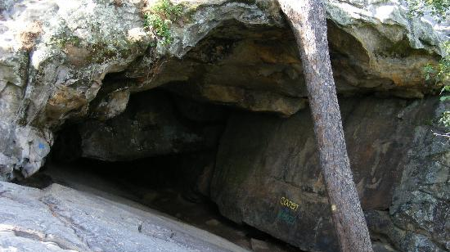
Den of Robbers
A place where criminals go hoping to escape the justice their crimes deserve.

Slide 13
Jeremiah 7:1-20
This is the word that came to Jeremiah from the Lord:
2 ‘Stand at the gate of the Lord’s house and there proclaim this message:
‘“Hear the word of the Lord, all you people of Judah who come through these gates to worship the Lord. 3 This is what the Lord Almighty, the God of Israel, says: reform your ways and your actions, and I will let you live in this place. 4 Do not trust in deceptive words and say, ‘This is the temple of the Lord, the temple of the Lord, the temple of the Lord!’ 5 If you really change your ways and your

Slide 14
actions and deal with each other justly, 6 if you do not oppress the foreigner, the fatherless or the widow and do not shed innocent blood in this place, and if you do not follow other gods to your own harm, 7 then I will let you live in this place, in the land I gave to your ancestors for ever and ever. 8 But look, you are trusting in deceptive words that are worthless.
9 ‘“Will you steal and murder, commit adultery and perjury, burn incense to Baal and follow other gods you have not known, 10 and then come and stand before me in this house, which bears my Name, and say, ‘We are safe’– safe

Slide 15
to do all these detestable things? 11 Has this house, which bears my Name, become a den of robbers to you? But I have been watching! declares the Lord. . .
20 ‘“Therefore this is what the Sovereign Lord says: my anger and my wrath will be poured out on this place – on man and beast, on the trees of the field and on the crops of your land – and it will burn and not be quenched.
Idolatrous congregants who acted unjustly and rapaciously
Believed the lie that they were okay and safe from judgment
Believed they were safe from God’s justice in the Temple which turned it into a den for robbers

Slide 16
Den of Robbers Jer. 7:1-20
Those who disobeyed God’s Word to become unjust and rapacious were deceived into thinking they would be safe from God’s justice in God’s Temple/House.

Slide 17
Herod’s Temple as Den of Robbers
Sanhedrin made up of Chief priests, teachers of law and other leaders who governed the faith and the Temple precincts had turned the Temple into a den for robbers

Slide 18
Herod’s Temple as Den of Robbers
Sanhedrin made up of Chief priests, teachers of law and other leaders who governed the faith and the Temple precincts had turned the Temple into a den or robbers

Slide 19
Herod’s Temple as Den of Robbers
Because House of Prayer repurposed into a Den for Robbers, Jerusalem missed the day God visited them
Misinterpreted and misapplied God’s Word
Robbed marginalized Jews of place with God’s people
Robbed Gentiles of place to seek God
Sanhedrin made up of Chief priests, teachers of law and other leaders who governed the faith and the Temple precincts had turned the Temple into a den for robbers

Slide 20
1. Repurposed Vs 41-46
God’s House of revelatory prayer’s repurposing as a sanctuary from God’s justice by Jerusalem’s leadership resulted in Jerusalem’s failure to recognize Jesus’ coming as God to bring her peace.
Failure to prayerfully seek God’s will from God’s Word

Slide 21
Living Temple
Eph. 2:19-22
Consequently, you are no longer foreigners and strangers, but fellow citizens with God’s people and also members of his household, built on the foundation of the apostles and prophets, with Christ Jesus himself as the chief cornerstone. In him the whole building is joined together and rises to become a holy temple in the Lord. And in him you too are being built together to become a dwelling in which God lives by his Spirit.

Slide 22
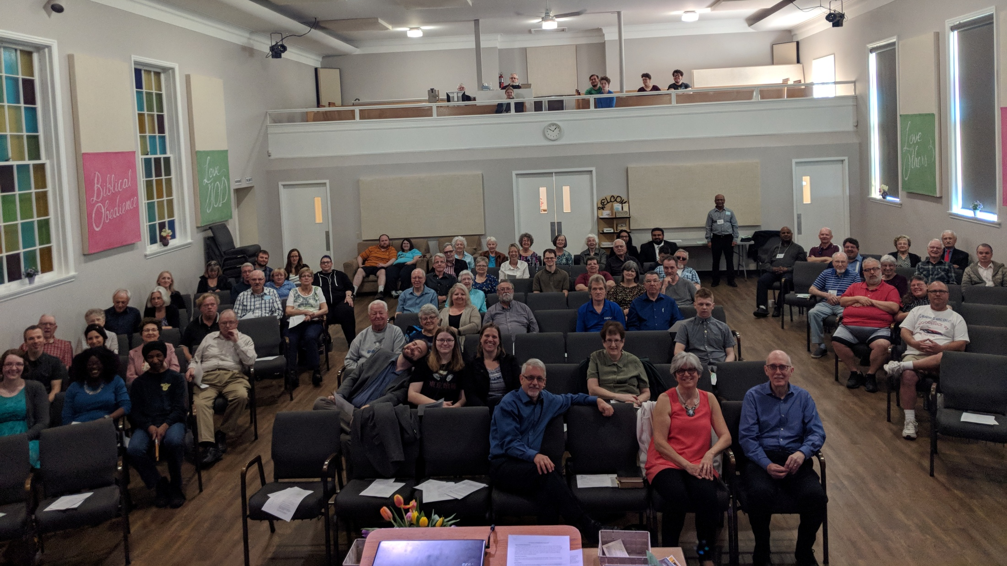
House of Prayer

Slide 23
Seekers find God
Inclusive
Transformation
Prayer
Revelation
Obedience

Slide 24
Den of Robbers

Slide 25
House of Prayer
1. Repurposed Vs 41-46
When churches’ leadership deemphasize or set aside prayerful handling of God’s Word during worship services, churches are repurposed to become dens of robbers.

Slide 26
What would you expect to happen where the teaching of the prayerfully handled Word of God is set aside during a church’s Sunday services?

Slide 27
2 Timothy 3:14-17
But as for you, continue in what you have learned and have become convinced of, because you know those from whom you learned it, and how from infancy you have known the Holy Scriptures, which are able to make you wise for salvation through faith in Christ Jesus. All Scripture is God-breathed and is useful for teaching, rebuking, correcting and training in righteousness, so that the servant of God may be thoroughly equipped for every good work.

Slide 28
How can Elliott avoid being repurposed as a house of prayer into a den of thieves?

Slide 30
45 When Jesus entered the temple courts, he began to drive out those who were selling. 46 ‘It is written,’ he said to them, ‘“My house will be a house of prayer”; but you have made it “a den of robbers”.’
47 Every day he was teaching at the temple. But the chief priests, the teachers of the law and the leaders among the people were trying to kill him. 48 Yet they could not find any way to do it, because all the people hung on his words.
Cleanse out the market to make room for his teaching
Luke 4:16-21 and the Good News
Correction of the Scribes’ misinterpretation and misapplications

Slide 31
45 When Jesus entered the temple courts, he began to drive out those who were selling. 46 ‘It is written,’ he said to them, ‘“My house will be a house of prayer”; but you have made it “a den of robbers”.’
47 Every day he was teaching at the temple. But the chief priests, the teachers of the law and the leaders among the people were trying to kill him. 48 Yet they could not find any way to do it, because all the people hung on his words.
Cleanse out the market to make room for his teaching
Luke 4:16-21 and the Good News
Correction of the Scribes’ misinterpretation and misapplications
Congregants coming to seek God’s face, to know and do his will

Slide 32
House of Prayer
1. Repurposed Vs 41-46
2. Reclaimed Vs 45-48
Jesus reclaimed the Temple court from the leadership’s misuse so he could accurately teach God’s Word to reveal God’s saving purposes to those who came prayerfully seeking God’s revelation.
Necessity of congregants’ personal reclaiming of house of prayer

Slide 33
House of Prayer
1. Repurposed Vs 41-46
2. Reclaimed Vs 45-48
Those who personally reclaim Sunday worship for seeking God’s will so they can obey him, will find what they seek when God’s prayerfully discerned Word is taught.
It does not matter how well God’s prayerfully discerned Word is taught if we are not ready to hear it

Slide 34
What are some things we can do to personally reclaim Sunday worship so that when God’s prayerfully discerned Word is taught, we may actually hear his voice speaking to us?
• Change in attitude and motivation
• Prayer in advance for our own hearts that they would be receptive to being led to salvation, to being taught, rebuked, trained in righteousness, ready to serve
• Prayer for those who will teach so that it is the very Word of God
• Quiet preparation the night before/morning of
Quiet devotional time
Praise Music
Everything prepared night before so it isn’t such a rush

Slide 36
But the chief priests, the teachers of the law and the leaders among the people were trying to kill him. 48 Yet they could not find any way to do it, because all the people hung on his words.
Leadership hated Jesus’ teaching
Why would the leadership hate what Jesus was revealing about God and his saving purposes?
Congregants’ hearts open and hungry for teaching

Slide 37
House of Prayer
1. Repurposed Vs 41-46
2. Reclaimed Vs 45-48
3. Reception Vs 47b-48
Jesus’ teaching of God’s Word to reveal his saving purposes divided listeners into resistant enemies who hated him for exposing their evil and those hungry for his every Word.
God’s prayerfully discerned and taught Word divides its listeners into different categories according to the congregants’ preparedness to receive what is taught.

Slide 38
What possible categories can listeners of God’s revelation fall into depending on their preparedness to receive God’s prayerfully discerned and taught Word?
Which one describes you?

Slide 39
Summary:
The prayerfully discerned and taught Word and its reception by prayerfully prepared worshippers is essential for Elliott becoming the inclusive church of mature multiplying disciples God intends it to be.
• Stray from making teaching of the prayerfully discerned Word of God a focal point of our gatherings and we become a den of robbers destined for destruction
• Stray from prayerfully preparing ourselves for Sunday worship and we foolishly rob ourselves of experiencing God in knowing and doing his will

